Slide 1
Water Logging
&
Salinity
Courtesy
Prof. Dr. Habib-ur-Rehman

Slide 2
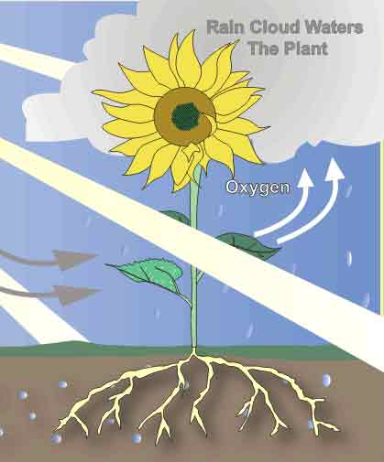
Water Logging
Rise of water table is called water-logging.
An agricultural land is said to be water-logged when its productivity gets affected by high water table.
Nutrients like nitrates are required by the plants which are produced by bacteria, and they require oxygen for survival. Water logging kills these bacteria.
Productivity gets affected when root zone of plants gets flooded with water for long time.
Soil water / root zone
Aeration zone
Intermediate zone
Lithosphere
Capillary zone

Slide 3
Water Logging (contd.)
As per WAPDA’s criterion, the land having depth to water table is less than 3 m is classified as water logged area.
Further Categories:
  Severely Water Logged Area (D = 0 -1.5 m)
  Less Severely Water Logged Area (D = 1.5 – 3 m)

Slide 4
Water Logging (contd.)

Slide 5
Causes of Water Logging
(1) Over and intensive irrigation
(2) Seepage of water from adjoining high lands
(3) Seepage of water through canals
(4) Impervious obstruction
(5) Inadequate natural drainage
(6) Inadequate surface drainage
(7) Excessive rain
(8) Irregular or flat topography

Slide 6
Causes of Water Logging
(1) Over and intensive irrigation
Policy of intensive irrigation increases water table.
To avoid this policy of extensive irrigation should be used.
(2) Seepage of water from adjoining high lands
Water from adjoining high lands may seep into subsoil of affected land and may raise water table.
(3) Seepage of water through canals
Water may seep through beds and sides of canal network, reservoirs etc. which increase water table (In Pakistan 69,200 km canals).
(4) Impervious obstruction
Due to impervious strata water table rises from upstream side.

Slide 7
(5) Inadequate natural drainage
Soil having less permeable substratum below pervious soil will not able to drain water deep into ground causes high water table.
(6) Inadequate surface drainage
If proper drainage is not available then the storm water constantly percolates and rise level of water table.
(7) Excessive rain
Excessive rainfall may create temporary water logging (less intensity for longer durations).
(8) Irregular or flat topography
In steep terrain water is drained quickly but in flat terrain drainage
is poor which raises water table.

Slide 8
Effect of Water Logging
Normal cultivation operations cannot be carried out easily in wet soil (makes cultivation operation difficult due to standing water).
Certain water loving plants like grasses, weeds etc grow fastly in water logged land and affects the growth of the crops.
Kills the bacteria which produces nutrients.
Causes the loss in crop yield.
Spread of mosquitoes and malaria.
Destruction of roads due to reduced bearing capacity.
Water logging leads salinity.
Causes dampness in buildings, appearance of salts on surface, weakens the plaster and produces ugly spots.
If salty soil is used to make bricks, salts appear on the wall surface.

Slide 9
Remedial Measures of Water Logging
1. Lining of canals and water courses
2. Reducing the intensity of irrigation
3. By introducing crop rotation
4. Optimum use of water
5. Providing intercepting drains
6. Provision of efficient drainage system
7. Improving natural drainage of area
8. Introducing to lift irrigation

Slide 10
Lining of canals and water courses
Lining of canal system reduces seepages of water.
2. Reducing the intensity of irrigation
In area where there is possibility of water logging, intensity of irrigation should be reduced.
3. By introducing crop rotation
Certain crops require more water and others requires less water so by rotation of crops avoid high water table.
4. Optimum use of water
Certain fixed amount of irrigation gives best results.
Less than and more than that reduces yield.

Slide 11
5. Providing intercepting drains
Intercepting drains along canals should be provided which prevent seeping canal water from reaching the water logged area.
6. Provision of efficient drainage system
A good horizontal drainage system provided for
rainstorm water (surface and sub-surface).
7. Improving natural drainage of area
To reduce percolation of water the water should
not stand for longer period.
8. Introducing to lift irrigation
It helps in lowering the water table through tube
wells (vertical drainage).

Slide 12
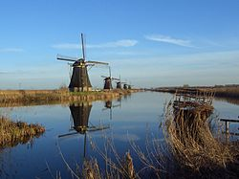
Dutch Wind Mills pumping water from WLS

Slide 13
Land Drainage
In irrigated area two types of drainage can be provided:
(1) Surface drainage
(2) Sub-surface Drainage / Tile Drainage

Slide 14
Surface drainage
Surface drainage is the removal of excess water by using and construction open ditches, field drains, land grading, and relative structures.
Open drains which are used to remove water from excess irrigated area and storm water are broad and shallow called shallow surface drains.
It carry runoff to outlet drains which are large enough to carry flood water, these drains called deep surface drains.
Land grading includes continuous land slope towards field drains.
Shallow surface drains are trapezoidal in cross section and constructed to carry normal storm water.
Deep surface drains are constructed to carry storm water plus excess irrigated water from shallow / tile drains.

Slide 15
Difference between Canal and Drain

Slide 16
2) Sub-Surface drainage / Tile Drainage
Subsurface drains are required for soils with poor internal drainage and high water table.
Tile drains are pipe drains and made up of porous material circular in cross section.
Diameter may vary from 10 to 30 cm.
These drains laid below ground level and connected with each other by open joints.
Construction of subsurface drainage is given below:
(I) Envelope filter:
The trenches are back filled with sand and excavated material.
The tile drains should not be placed below less permeable strata.
When it is situated below less permeable strata then they are surrounded by graded gravels called ‘Envelope Filters’.
It prevent inflow of soil into drain and increases effective tile diameter.

Slide 17
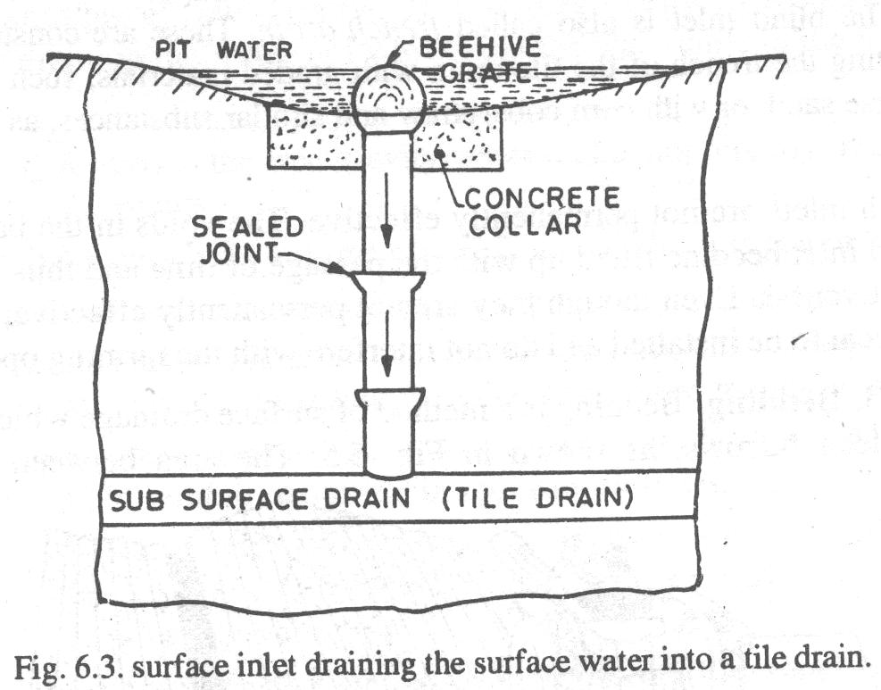

Slide 18
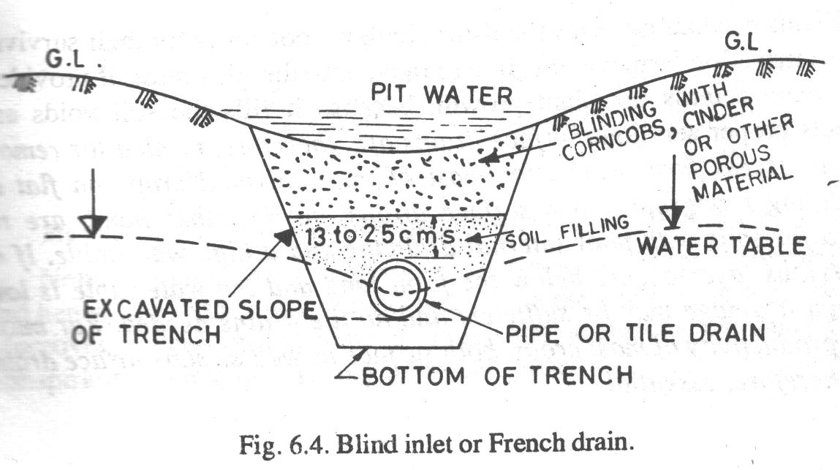

Slide 19
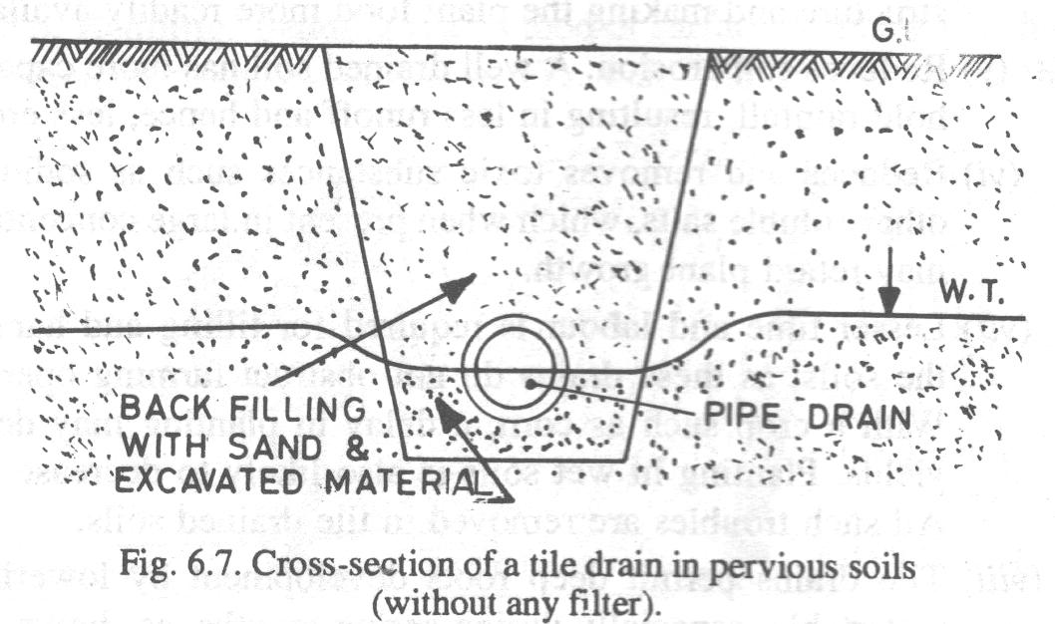
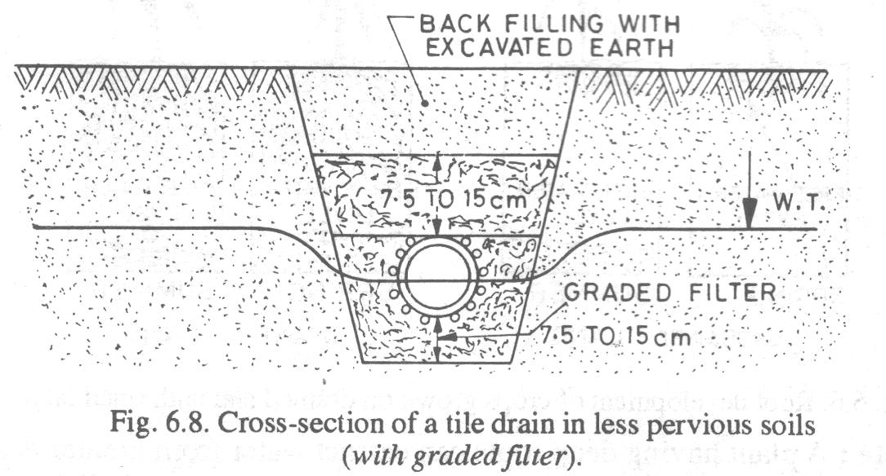

Slide 20
(II) Outlets for tile drains
Water from tile drain is discharged into some bigger drains called surface drains.
The water from tile drains may be discharged by gravity or pumping.
(A) Gravity outlets
(B) Pump outlets

Slide 21
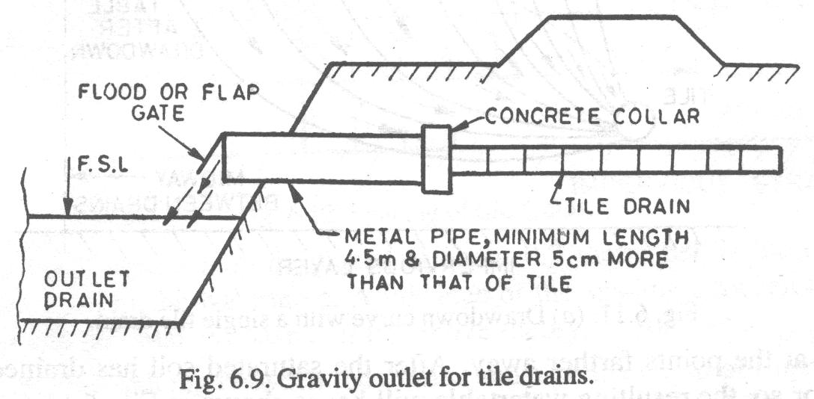
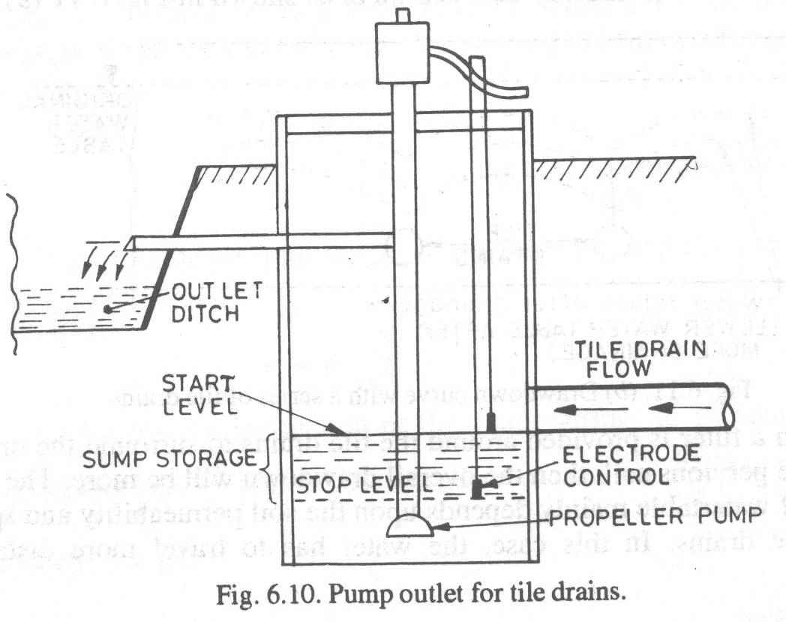

Slide 22
Spacing of Tile Drains

Slide 24
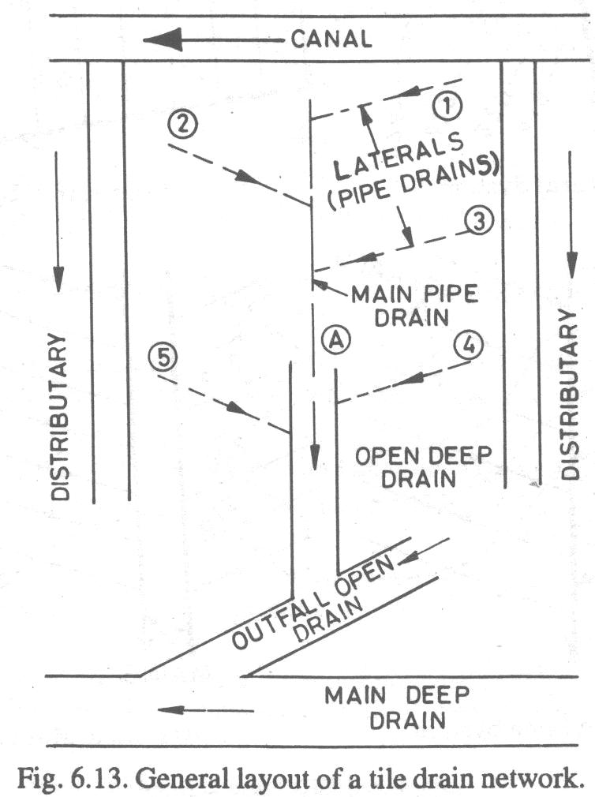
Layout of Tile Drainage
Tile drains are aligned in different ways depending upon topography of the area.
Various types of layout of tile drains:
Natural System
Grid Iron System
Herring Bone System
Double Main System
Intercepting Tile Drains

Slide 25
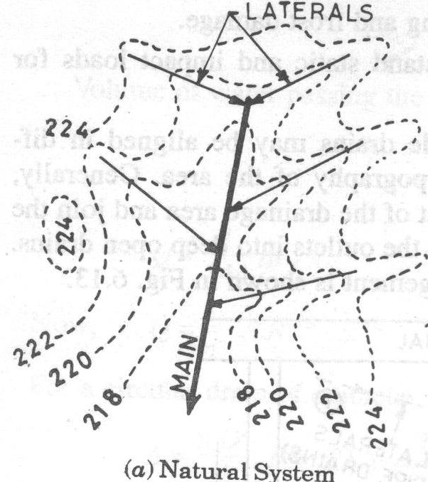
(1) NATURAL SYSTEM
This system is adopted in rolling topography where drainage of isolated areas is required.

Slide 26
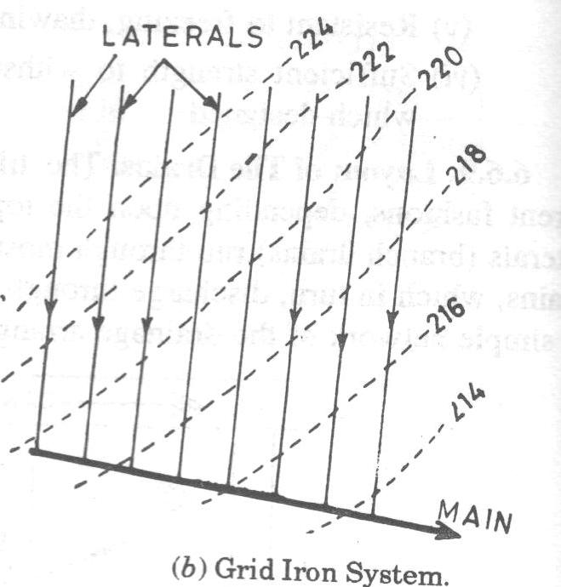
(2) GRID IRON SYSTEM
In this system laterals are provided only on one side of the main.
It is adopted when land is practically level.

Slide 27
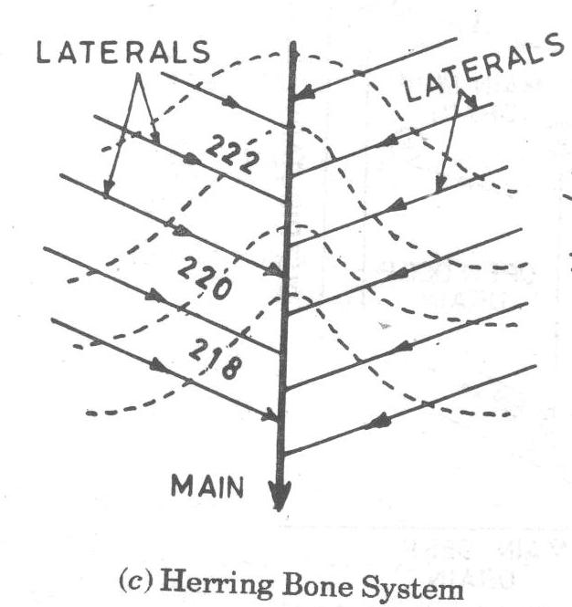
(3) HERRING BONE SYSTEM
In this system laterals join the main from each side alternatively.
It is adopted when main is laid in depression.

Slide 28
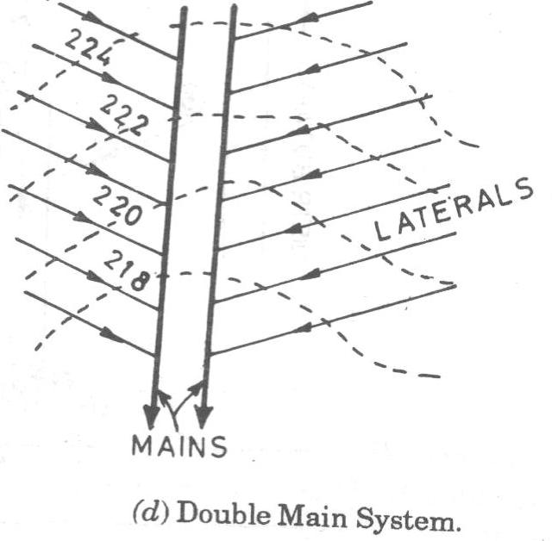
(4) DOUBLE MAIN SYSTEM
It has two mains with separate laterals for each main.
It is adopted when bottom of depression is wide.

Slide 29
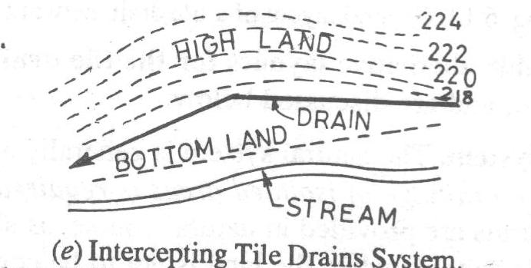
(5) INTERCEPTING TILE DRAINS
In this system there is no laterals drains.
A main is provided at toe of slope.
It is adopted when main source of drainage is from hilly land.

Slide 30
Salinity
Salinity is the concentration of dissolved salts found in water.
It is measured as the total amount of dissolved salts in parts per thousand (sometimes called PSU or Practical Salinity Units by scientists). Ten parts per thousand is equal to one percent.
Injurious salts are Alkali Salts like NaCl, Na₂SO₄ and Na₂CO₃. Na₂CO₃ is most harmful and NaCl is least harmful. These salts are soluble in water.
In soils, salt moves with water.
In water logged soils, salt appears on the surface with water due to capillary action, water gets evaporated leaving layer (5-7.5 cm) of salts on the surface (Efflorescence).
The primary man-made cause of Salinity is irrigation.
River water or groundwater used in irrigation contains salts, which remain in the soil after the water has evaporated.

Slide 31
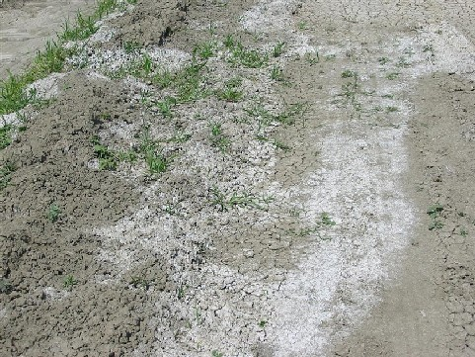
Ground affected by Salinity

Slide 32
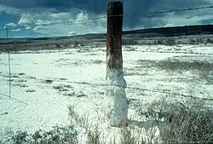

Slide 33
Salinity Control
The aim of soil Salinity Control is to prevent soil degradation by salination and Reclaim salty (saline) soils.
Soil reclamation is also called soil improvement, rehabilitation, remediation, or recuperation. It requires:
(1) Efficient Drainage
(2) Leaching
LEACHING
The primary method of controlling soil salinity is to permit 10-20% of the irrigation water to leach the soil, be drained and discharged through an appropriate drainage system.
The salt concentration of the drainage water is normally 5 to 10 times higher than that of the irrigation water, thus salt export not matches salt import and thus it is removed.
When Sodium Carbonate is present in saline soil, Gypsum (CaSO₄) is generally added to the soil before leaching by mixing with water. Na₂CO₃ reacts with CaSO_{4,} forms Na₂SO₄ which can be leached out.

Slide 34
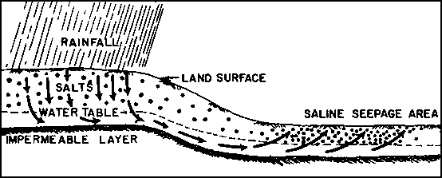
Saline Seepage Area

Slide 35
Thank You

