Slide 1
Design of Wells
Courtesy
Prof. Dr. Habib-ur-Rehman

Slide 2
Wells
For Irrigation purpose, the groundwater sources can be:
Wells (Open Wells & Deep Wells)
Springs (When GW Table cuts the land profile)
Karez, Qanat or Kanat (practiced in Baluchistan, Iran and Afghanistan, It is a tunnel in soft formation in the foot hills, cutted into the water table at upper end causing water to flow by gravity).

Slide 3
Open Wells
Hand dug wells in shallow water table.
Up to 10’ diameter.
The depth is less than 100’.
Sides are held by loosely jointed bricks.
Bottom is loaded with gravel to stop sand boil.
It has low discharges
2) Deep Wells
Wells penetrating to deep aquifers are machine bored.
Can be drilled in solid rocks (sand stone, lime stone).
When drilled in alluvium, they are provided with a screen.
Area of small diameters, less than 12”.
Can produce high discharge, up to 2.5 cfs.

Slide 4
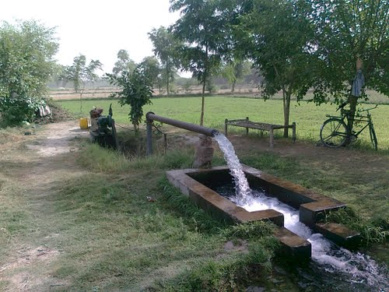

Slide 5
Types of flow / aquifer through a well
Steady Unconfined
Steady Confined
Unsteady Unconfined
Unsteady Confined

Slide 6
Steady Flow Unconfined (water table) Well

Slide 7
Steady Flow Confined (artesian) Well

Slide 12
Design of Well
Deep wells in rocky or consolidated formations are simple to design as they do not require a Screen and Gravel Filter to hold the formation.
Deep wells in Alluvium, fine sand or sand aquifers are more complicated as they requires Screen and Gravel Filter.
An improper design of Screen may result in reduced discharge.
A good design should have:
(i) Optimum Discharge
(ii) Minimum drawdown
(iii) Long life

Slide 13





Slide 14
Elements to be designed
Diameter of the Well
Well depth
Borehole diameter
Well Screen
  Length of screen and its location
  Slot size of the screen
  Shape of the opening and %age open area
Gravel Pack design (if required)

Slide 15
Well Diameter
Well discharge is inversely proportional to Log (R/rw).
Increase in Well Diameter increases discharge very little, but more drilling cost.
Hence Well Diameter is fixed on the basis of size of the pump which is placed inside with proper clearance say 2”.
For economy, the Well Diameter may be reduced below the Pump Setting.
2) Well Depth
Well Depth is usually up to the bottom of the aquifer.
Where aquifer thickness is too large then the desired length can be computed for the design discharge.
3) Borehole Diameter
Borehole diameter should be bigger than the well diameter.
BHD = Well dia. + 2 thickness of casing pipe + 2 thickness of Gravel Pack.

Slide 16
4) Well Screen
Screen Length
  Homogeneous artesian aquifer
  Screen Length = 70 to 80 % of aquifer thickness (B).
  Screen has to occupy the bottom portion (to leave space for drawdown).
  Homogeneous unconfined aquifer
  Screen Length = 33 to 50 % of aquifer thickness (B).
Screen Slot Opening
  Best opening is V-shaped, it facilitates the particles to move into the well without clogging.
  It is made by winding cold drawn wire approximate triangular in section around a cylindrical frame of rods.
  Other are simple rectangular slot cut in PVC, fibre glass pipes.
  For wells without Gravel Filter, the size of slot opening 30 – 50 % retaining sand.
  For Gravel Pack material slot size is kept 90 % retained material.

Slide 17
(c) Screen Diameter
Knowing the length and slot size (% open area), well screen diameter can be obtained by fixing the entrance velocity equal to or less than 0.1 fps.
At this velocity range:
the frication loss through the screen is negligible.
Encrustation rates are minimum.
Corrosion rates are minimum (more life).

Slide 18
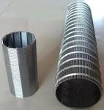
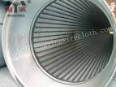
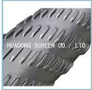
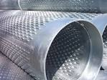

Slide 19
5) Design of Gravel Pack
Gravel pack becomes necessary when formation consists of fine uniform sand or alluvium.
Plot gradation curve for the finest material aquifer layer.
Multiply 70% size of the aquifer material with 4 - 9.
  Use 4 for fine uniform sand.
  Use 6 for coarse non-uniform sand with no silt.
  Use 7 for sand of highly non uniform gradation.
Place the results of multiplication on same graph paper, which gives the first point on the sieve analysis curve of the Gravel Pack material.
Draw through this initial point a smooth curve parallel to the sieve analysis curve of formation material.
Uniformity coefficient (d₄₀ / d₉₀ of material) should be as low as possible (less than 2.5).
Select 5 sieve sizes that cover the spread of the curve. Set a permissible range between 8-10% above and below selected sieve size.
The thickness of gravel pack should be 3 – 8”.

Slide 20
Thanks

