Slide 1
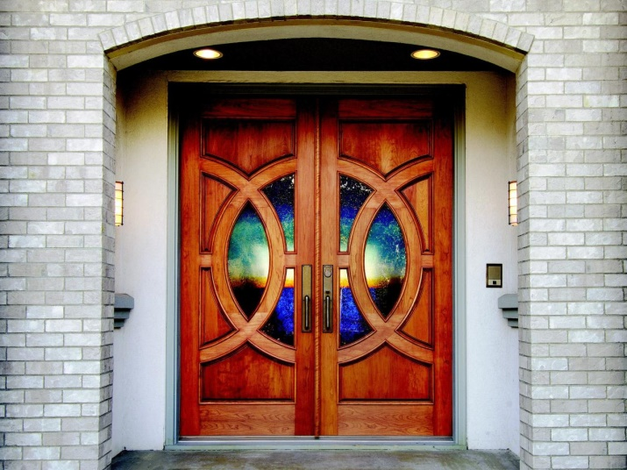
Doors
INSTRUCTOR: SYED ARIF HUSSAIN

Slide 2
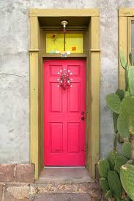
Doors
Necessary for connecting one area to another
  Protection & Privacy
Contribute to the atmosphere of a room and give balance & design to the exterior of a structure.

Slide 3
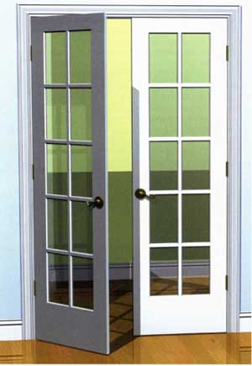
Door Types
Based on architectural style, costs, personal taste
Stile-and-rail
Swinging
Sliding
Garage doors

Slide 4
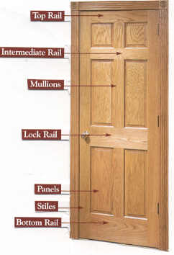
Stile-and-Rail Doors
Strong heavy frame around perimeter

Slide 5
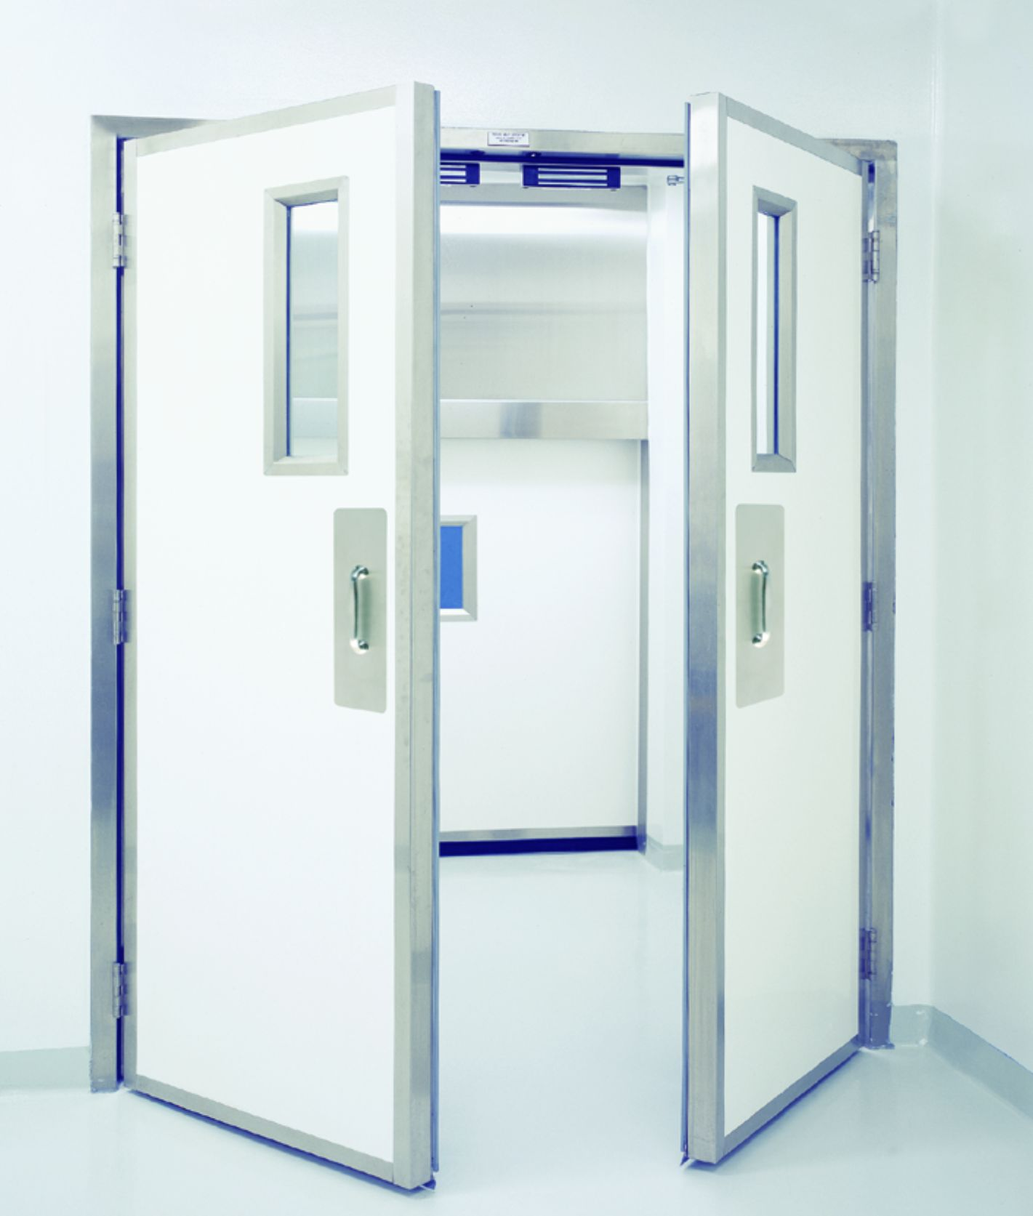
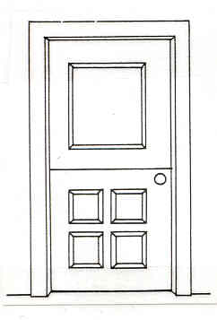
Swinging Doors
Placed on hinges so it swings out from the wall
Most secure
Why was the Dutch door created?
Dutch door

Slide 6
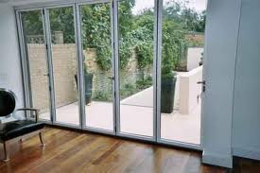
Sliding Doors
Set on a track and are opened and closed by sliding

Slide 7
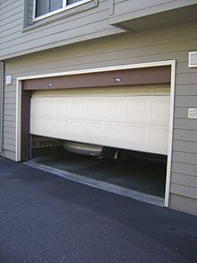
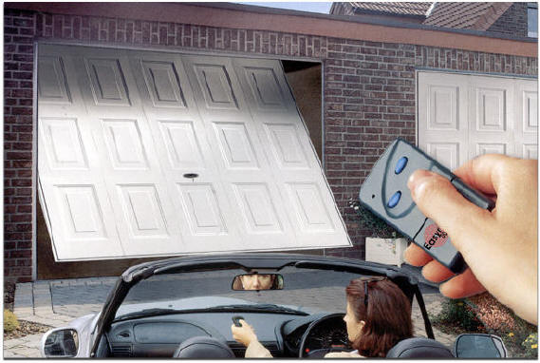
Garage Doors
Overhead sectional
One-piece overhead
  Wood
  Metal
  Fiberglass

Slide 8
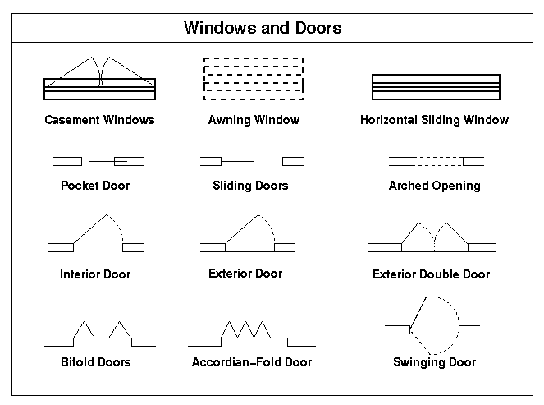
Door Symbols
Standard door symbols are used on construction drawings to communicate the type and locations of doors in a structure.

Slide 9
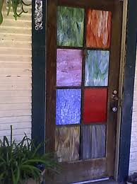
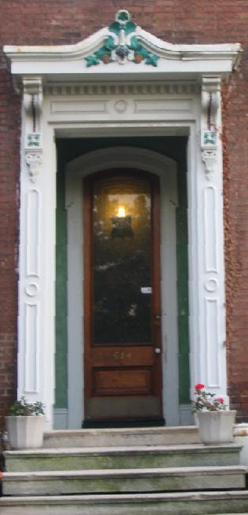
Door Treatments
Accent painting
Molding
Decorative hardware
Carvings
Stained glass inserts

Slide 10
CREATING DOORS

Slide 11
CREATING MAIN GATE

Slide 12
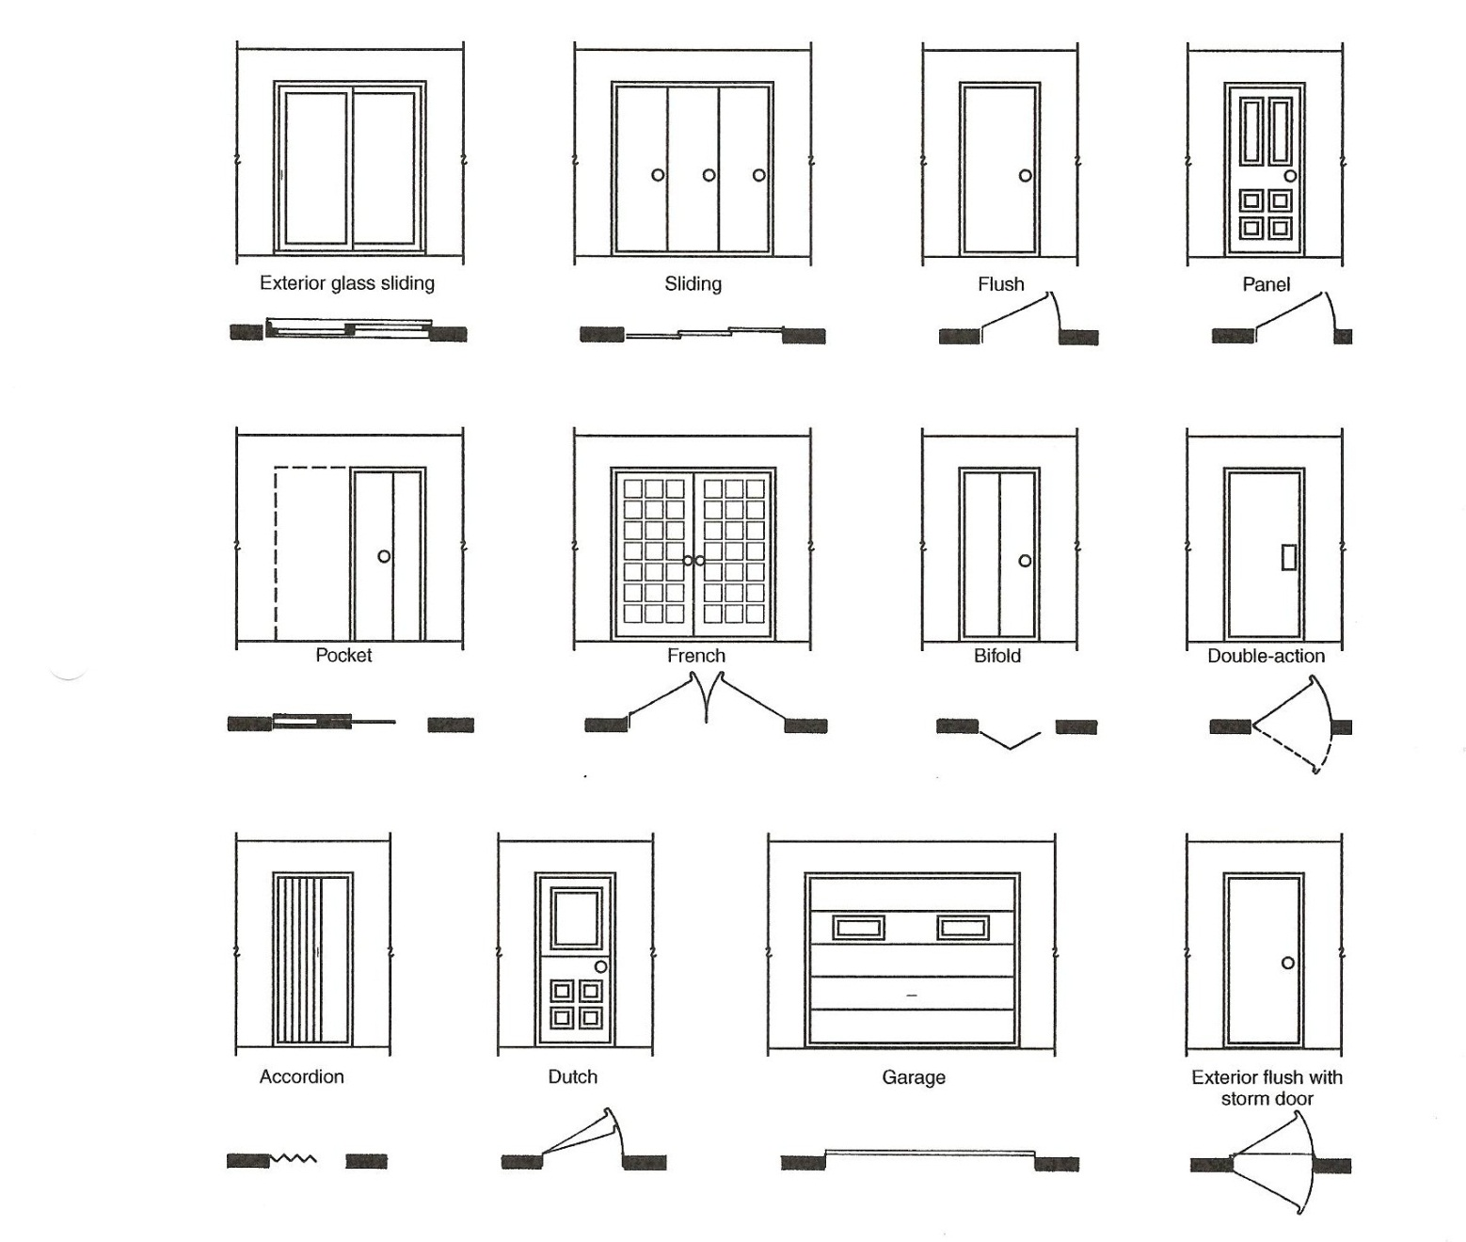

Slide 13
