Slide 1
Introduction to House plan Part-1
Submission Drawings
Instructor: Syed Arif Hussain

Slide 2
Contents to be Covered
Submission Drawings
Location Plan
Site Plan
Foundation Drawings
Plan of Building
Elevation of Building
Section of Building
Other Requirements for Submission Drawings

Slide 3
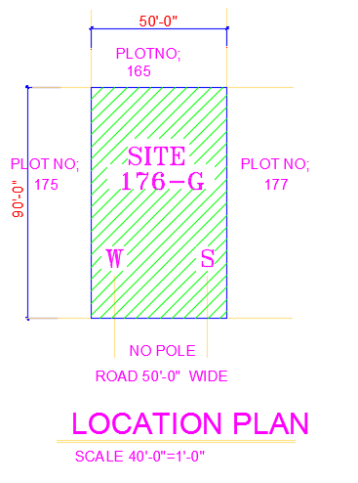
Location plan
A location plan provides an illustration of the proposed development in its surrounding context.

Slide 4
Site Plan
A site plan is a large scale drawing that shows the full extent of the site for an existing or proposed development.
A site plan usually shows a building footprint, travel ways, parking, drainage facilities, sanitary sewer lines, water lines, trails, lighting, and landscaping and garden elements.

Slide 5
Cont.…
The information shown on a site plan will vary depending on the size and nature of the project, however, certain information is likely to appear on most site plans:
Title block, giving the project name, scale used, and so on.
Directional orientation
Roads, drainage facilities, sanitary sewer lines, water lines, and landscaping and garden elements.

Slide 6
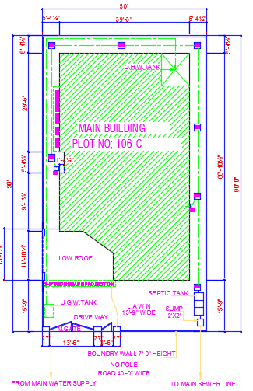

Slide 7
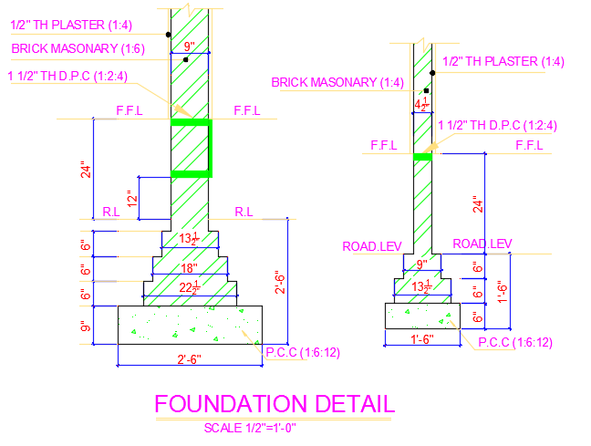
Foundation Drawings
The foundation plan is a plan view drawing, in section, showing the location and size of footings, piers, columns, foundation walls, and supporting beams.

Slide 8
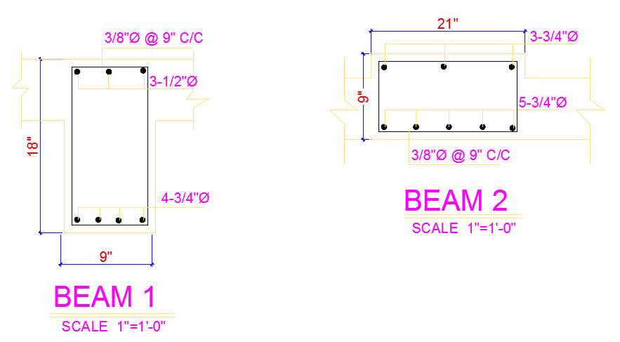

Slide 9
Plan
Plan of building represents a horizontal section of building at given height seen from top.
It is a general convention to imagine that the building has been cut down by a horizontal plan at the sill level of the window and is seen from the top after removal of the so cut part.
The plan shows that arrangement of rooms, verandah, or corridor, position of door, and window and other opening along with their respective sizes.

Slide 10
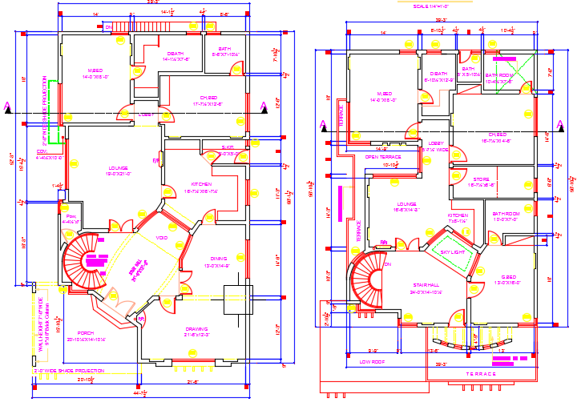

Slide 11
Elevation
An “elevation” is a drawing that shows the front or side of something.
A floor plan, by contrast, shows a space from above – as if you are looking down on the room from the ceiling. Thus, you see the tops of everything, but you cannot view the front, side or back of an object.
An elevation gives you the chance to see everything from the other viewpoints.

Slide 12
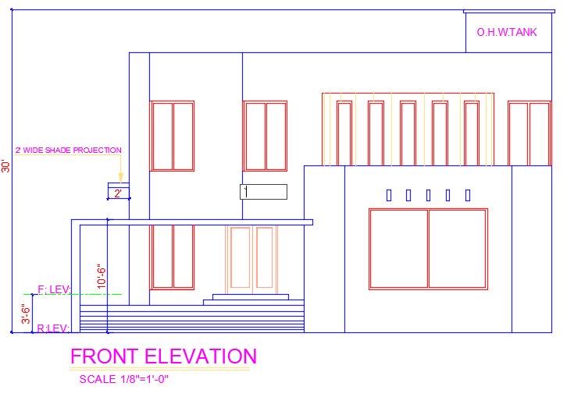

Slide 13
Section
A section is a vertical slice through a building with one half removed so we can look inside.
The section reveals simultaneously its interior and exterior profiles, the interior space, and the material, and providing a view of the object that is not usually seen.

Slide 14
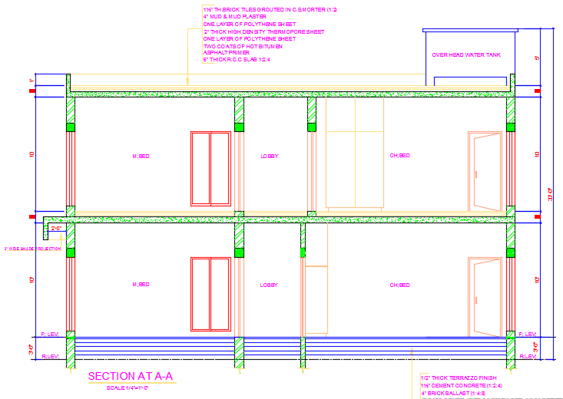

Slide 15
Other Requirements
Map Cosmetics
Septic tank detail
O.H.W. Tank Detail
U.G.W. Tank Detail
R.C.C Slab
Stair Detail
Schedule of Doors and Windows
Schedule of Areas (Covered Areas)

