Slide 1
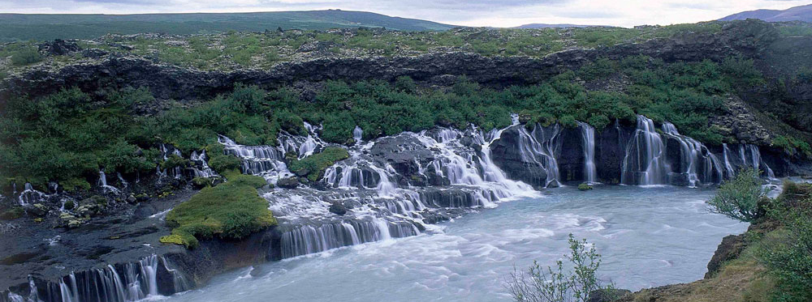
RUNOFF
LECTURE 10

Slide 2
RUNOFF
Runoff may be defined as that part of precipitation as well as any other flow contributions which appear in surface streams of either perennial or seasonal nature.
It is the flow collected from a drainage basin appearing at the outlet of the basin or catchment
The water which constitutes stream flow may reach the stream or channel by any of the several routes from the point where it first reaches as precipitation

Slide 3
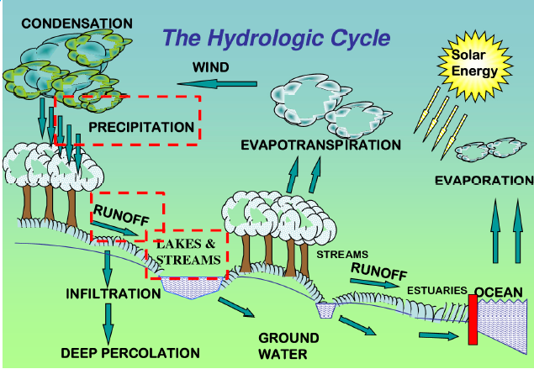

Slide 4
SOURCES OF RUNOFF
There are following sources of channel runoff
  Precipitation that directly occurs on stream surface or river surface
  Surface runoff/ overland flow
  Interflow
  Groundwater flow
Direct Run Off
Base Flow

Slide 5
OVERLAND FLOW/ SURFACE RUNOFF
It is that water which travels over the ground surface to the channel
The channel may be any depression which may carry a rivulet of water
Such channels are numerous and the distance water must travel as surface runoff in some cases is relatively short rarely more than hundred feet
Therefore surface runoff soon reaches a channel and if it occurs in sufficient quantity, is an important parameter in forming the peak flood in the channel
The amount of surface runoff may be very small, since surface flow over a permeable soil surface can only occur when the rainfall rate exceeds the local infiltration capacity

Slide 6
OVERLAND FLOW/ SURFACE RUNOFF
In many small and moderate storms, surface runoff only occurs from impermeable and saturated areas within the basin or from the precipitation that falls directly on the stream surface
Except in urban areas, the extent of such areas is small part of the basin area
Hence surface runoff is the important part in stream flow only with very heavy or high intensity storms

Slide 7
INTERFLOW
Some of the water that infiltrates soil surface may move laterally through the upper soil layers until it enters a stream or a channel
This water is called interflow or subsurface storm flow
This water moves slower than the surface runoff and reaches the stream later
The proportion of total runoff that flows as interflow depends on the physical features of the basin
A thin soil cover overlying a rock, hard pan or plowbed a short distance below the surface favors substantial quantities of interflow
Whereas uniformly permeable encourages deeper percolation to ground water resulting in less interflow
Although travelling very slow than overland flow, It may be huge in quantity especially in storms of moderate intensity and hence may be a principle factor in the small rises in stream

Slide 8
GROUND WATER FLOW
Some precipitation percolates deep into the ground until it reaches the water table
The ground water accretion may eventually discharge into the streams as ground water also called base flow or dry-weather flow if the water table intersects the stream or channel
This contribution in streams doesn’t fluctuate rapidly because of its low velocity
Basins having highly permeable soils and large effluent ground water bodies show sustained high flow throughout the year with a relatively small difference in mean and flood flow
Basins having low permeable soils and large influent ground water bodies have higher peak flow and average flow ratios

Slide 9
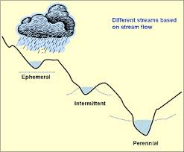
GROUND WATER FLOW

Slide 10
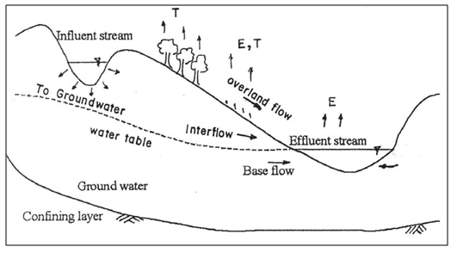
FACTORS AFFECTING SURFACE RUNOFF
There are to main categories of surface runoff
  Related to precipitation characteristics
  Related to physical characteristics of the basin

Slide 11
FACTORS AFFECTING SURFACE RUNOFF
Related to precipitation characteristics:
  type of precipitation
  Intensity of rainfall
  Duration of rainfall
  Distribution of storm intensity on basin area
  Direction of storm movement
  Other climatic conditions which affect evaporation and transpiration

Slide 12
FACTORS AFFECTING SURFACE RUNOFF
Related to physical characteristics of basin:
  Land use
  Type of soil
  Area of water shed
  Elevation of area
  Lope of area
  Orientation
  Type of drainage network

Slide 13
ESTIMATION OF RUNOFF
Estimation of runoff is necessary for the following reasons
  For determining the storage or yield available
  For calculating inflow design floods
The runoff of a catchment can be computed daily, monthly or yearly as the need be
There are various methods of computations of runoff that can be classifies as follows:
  Empirical formulae and tables
  Infiltration method
  Rational method
  Unit hydrograph method
  By estimating losses

Slide 14
EMPIRICAL FORMULAE AND TABLES
These formulae are derived considering the factors affecting
  Surface runoff co-efficient method
  Inglis formula
  Lacey’s formula
  Khosla formula
  SCS Curve number method
Surface runoff co-efficient method
  Runoff (cm) = co-efficient x rain fall (cm)
  R = K.p
  The value of co-efficient “K” depends upon the factors which affect the runoff

Slide 15

EMPIRICAL FORMULAE AND TABLES
Inglis Formula (Bombay-Deccan catchment)
$R=\frac{(P−17.8)x P}{254}$
  P and R are in cm
  Numerical example:
  Determine runoff in cm when precipitation over a watershed area is 23cm.

Slide 16
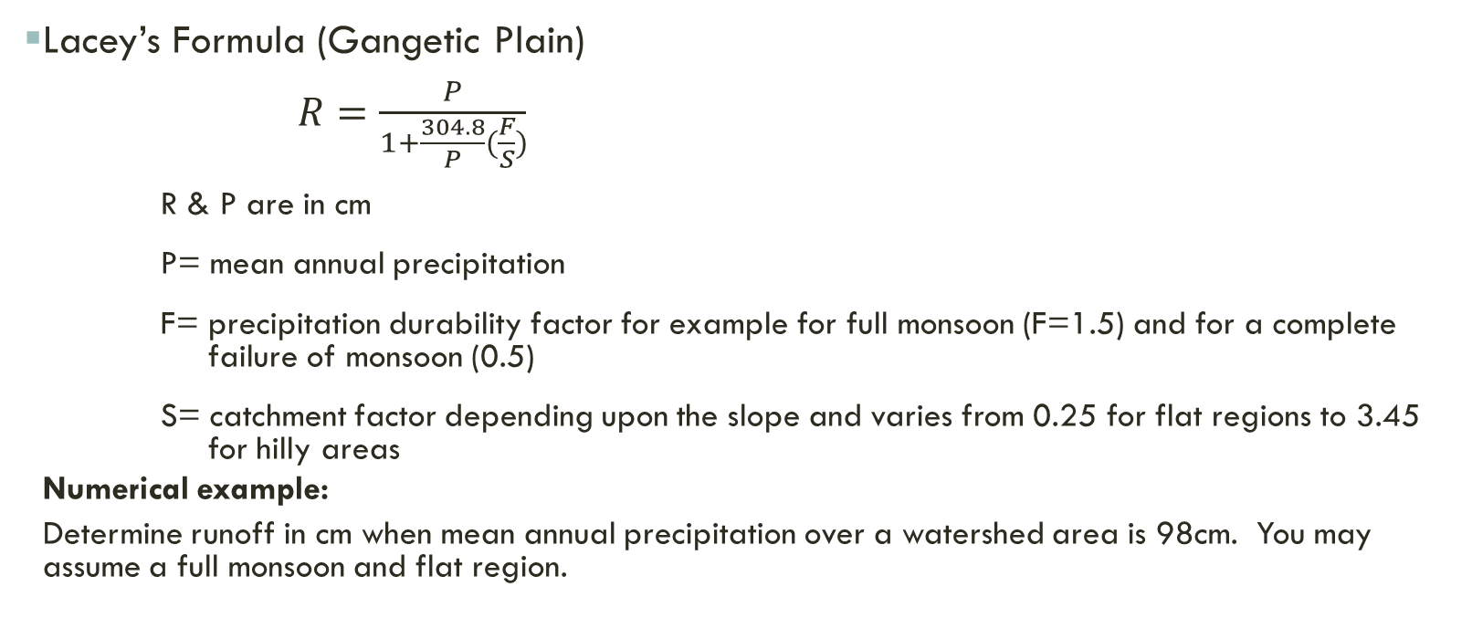
EMPIRICAL FORMULAE AND TABLES
Lacey’s Formula (Gangetic Plain)
$R=\frac{P}{1+\frac{304.8}{P}(\frac{F}{S})}$
R & P are in cm
P= mean annual precipitation
F= precipitation durability factor for example for full monsoon (F=1.5) and for a complete failure of monsoon (0.5)
S= catchment factor depending upon the slope and varies from 0.25 for flat regions to 3.45 for hilly areas
  Numerical example:
  Determine runoff in cm when mean annual precipitation over a watershed area is 98cm. You may assume a full monsoon and flat region.

Slide 17
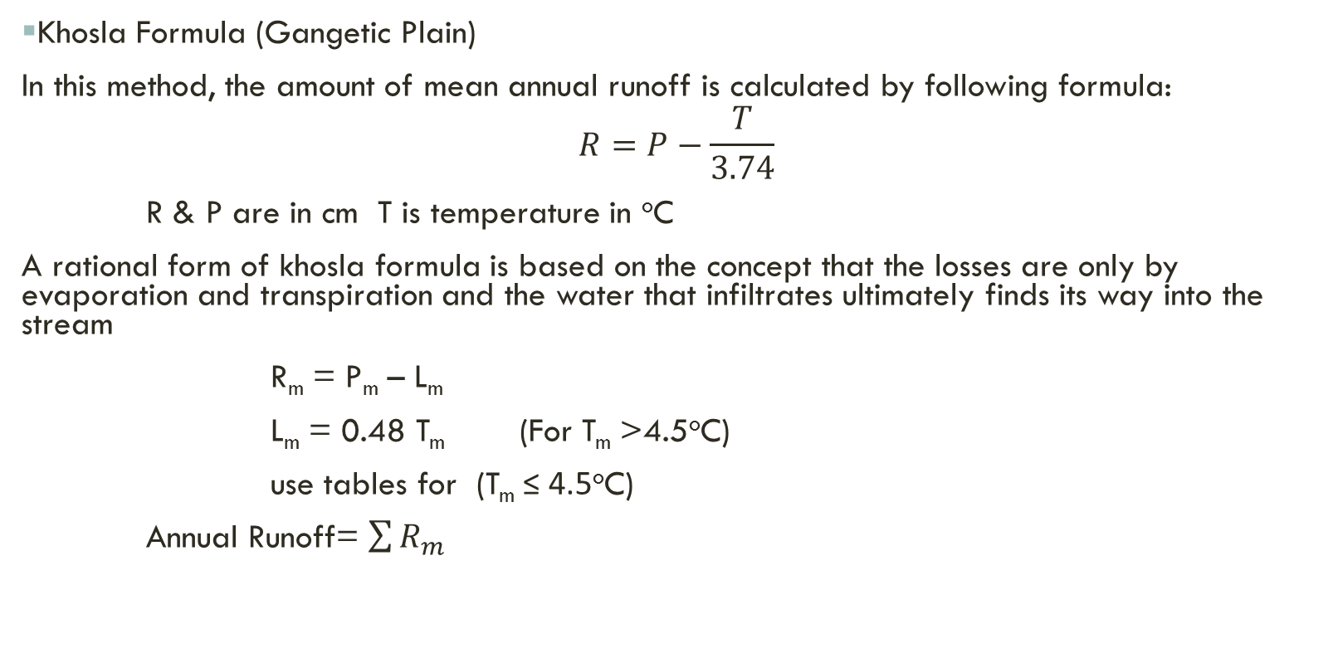
EMPIRICAL FORMULAE AND TABLES
Khosla Formula (Gangetic Plain)
In this method, the amount of mean annual runoff is calculated by following formula:
$$R=P−\frac{T}{3.74}$$
R & P are in cm T is temperature in ºC
A rational form of khosla formula is based on the concept that the losses are only by evaporation and transpiration and the water that infiltrates ultimately finds its way into the stream
R_{m} = P_{m} – L_{m}
L_{m} = 0.48 T_{m} (For T_{m} >4.5ºC)
use tables for (T_{m} ≤ 4.5ºC)
Annual Runoff= $\sum{R_{m}}$
R_{m} = monthly runoff in cm must be ≥0
P_{m} = monthly rainfall in cm
L_{m} = monthly Losses in cm
T_{m} = mean monthly temperature in ºC

Slide 18
NUMERICAL EXAMPLE
For a catchment the mean monthly rainfall and temperature are given. Calculate annual runoff and runoff Co-efficient by khosla formula.
Month | Temperature (ºC) | Rainfall (cm) | Month | Temperature (ºC) | Rainfall (cm)
Jan | 12 | 4 | July | 31 | 32
Feb | 16 | 4 | August | 29 | 29
March | 21 | 2 | Sept | 28 | 16
April | 27 | 0 | Oct | 29 | 2
May | 31 | 2 | Nov | 19 | 1
June | 34 | 12 | Dec | 14 | 2

Slide 19
SCS CURVE NUMBER METHOD
The SCS Runoff Curve Number method is developed by the United States Department of Agriculture (USDA) Soil Conservation Service (SCS) and is a method of estimating rainfall excess from rainfall
The major disadvantages of the method are sensitivity of the method to Curve Number (CN) values
The basis of the curve number method is the empirical relationship between the retention (rainfall not converted into runoff) and runoff properties of the watershed and the rainfall.

Slide 20
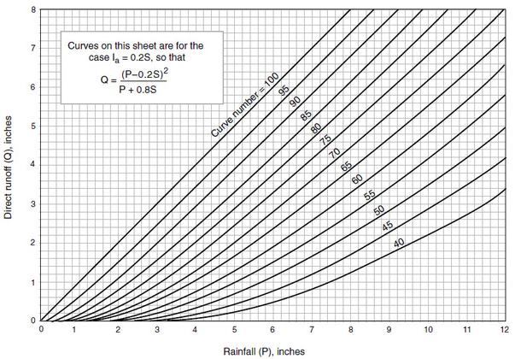

Slide 21
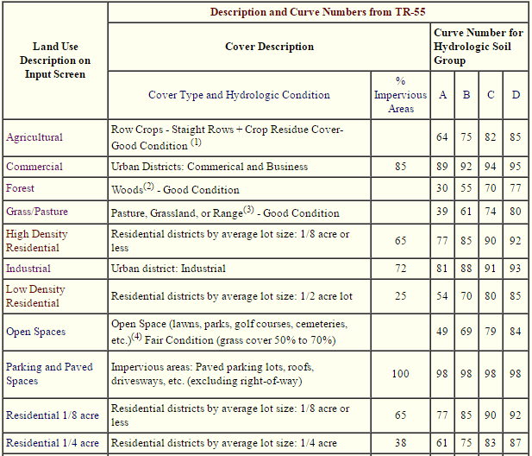
Soil Categories:
Category A:
Soil with very high infiltration rates when wetted thoroughly
Category B:
Soils with moderate infiltration rates when thoroughly wetted
Category C:
Soils with slow infiltration rates when thoroughly wetted
Category D:
Soils with very slow infiltration rates when thoroughly wetted

Slide 22
SCS CURVE NUMBER METHOD
Compute Surface runoff for a highly dense residential area with 65% impervious area. The soil in area exposed to the precipitation is soil with slow infiltration rate. Precipitation in the area is 9”.

Slide 23
BY APPLYING UNIT hydrograph method
Hydrograph is a DRO hydrograph resulting due to unit effective precipitation (1cm/ 1”) over the watershed
Area under unit hydrograph is always 1cm or 1” . It means volume of the precipitation is normalized with watershed area
Unit hydrograph gives the time distribution of surface runoff due to unit effective precipitation over the watershed
For any value of effective precipitation over the watershed, time distribution of the surface runoff can be obtained by using ordinates of unit hydrograph

Slide 24
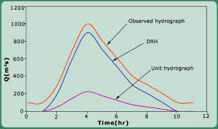
BY APPLYING UNIT hydrograph method

Slide 25
BY APPLYING UNIT hydrograph method
Procedure:
For the rainstorm compute effective precipitation
Peff= Pt – (E+I+T)
Compute time of concentration tc
Select duration of unit hydrograph
Pick the value of Qp from the unit hydrograph
Compute the Qp for given x(cm) precipitation
  (Qp)x = x . (Qp)UHG
Time of concentration: (t_{c}) it is the time required by a drop of water to reach at the outlet from the farthest location of watershed

Slide 26
BY APPLYING UNIT HYDROGRAPH METHOD
Limitation:
  Amount of rainfall is uniform over the whole watershed
  Intensity of precipitation is uniform throughout the area
  Applicable for smaller area ≤ 500 km²
  Method is applicable for tropical watersheds

Slide 27
RATIONAL FORMULA
Peak discharge
Runoff Coefficient
    Q_{P} =Q = CIA
    Runoff co-efficient depends upon surface conditions (0.05-0.95)
    Assumptions:
    Rainfall is uniform throughout the area
    Intensity used is average intensity of storm
Area of watershed
Rainfall intensity

