Slide 1
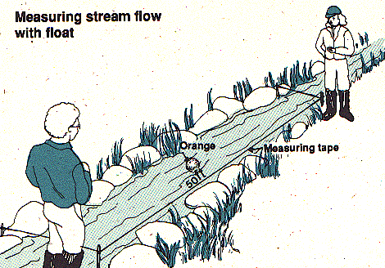
STREAM GAUGING
LECTURE 9

Slide 2
STAGE-DISCHRAGE RELATIONSHIP
The stage record is transferred to a discharge record by calibration
Control rarely has a regular shape for which discharge can be computed by analytical methods
Calibration is accomplished by relating field measurements of discharge with simultaneous river stage

Slide 3
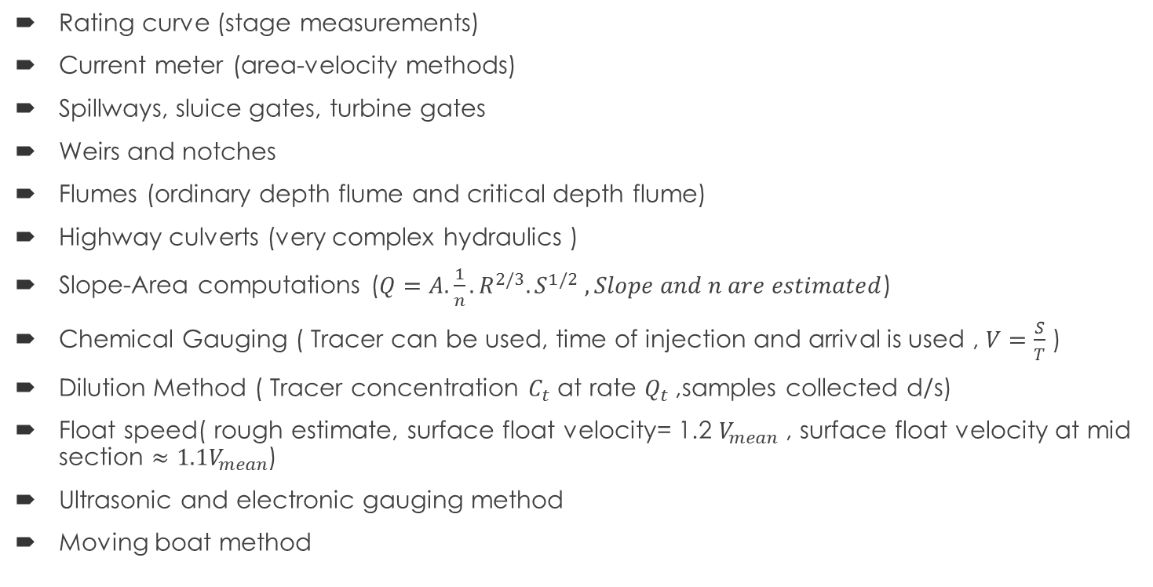
METHODS OF DISCHARGE MEASUREMENT IN RIVERS
Rating curve (stage measurements)
Current meter (area-velocity methods)
Spillways, sluice gates, turbine gates
Weirs and notches
Flumes (ordinary depth flume and critical depth flume)
Highway culverts (very complex hydraulics )
Slope-Area computations ($Q=A.\frac{1}{n}.R^{2/3}.S^{1/2} , Slope and n are estimated$)
Chemical Gauging ( Tracer can be used, time of injection and arrival is used , $V=\frac{S}{T}$ )
Dilution Method ( Tracer concentration $C_{t}$ at rate $Q_{t}$,samples collected d/s)
Float speed( rough estimate, surface float velocity= 1.2 $V_{mean}$ , surface float velocity at mid section $≈1.1V_{mean}$)
Ultrasonic and electronic gauging method
Moving boat method

Slide 4
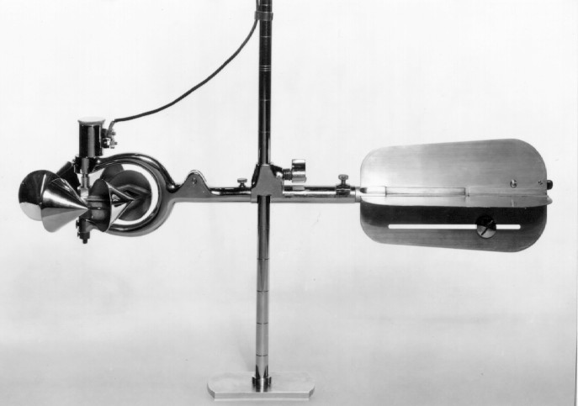
CURRENT METER METHOD
Types of current meter
  Price Current meter
  Propeller type current meter
Price Current Meter
  Most common current meter in USA, Price meter

Slide 5
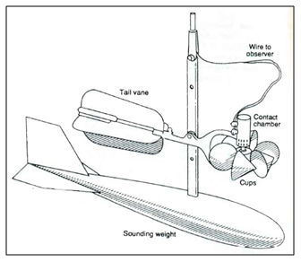
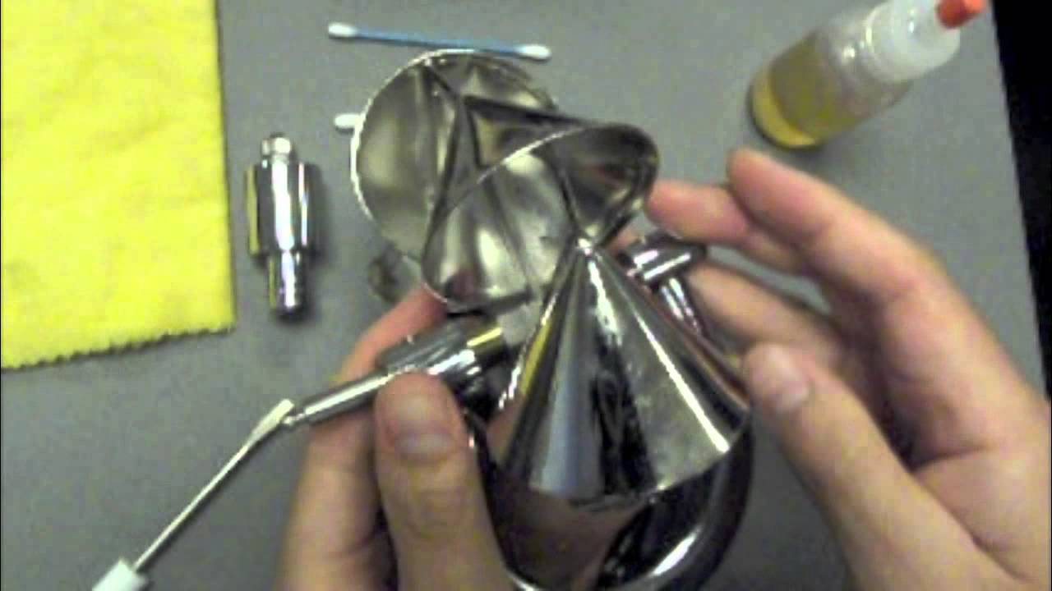
CURRENT METER METHOD
Price Current Meter
  Consists of 6 conical cups, rotating about a vertical axis
  Electric contacts driven by cups close a circuit through the battery and the wire of supporting cable to cause a click for each revolution (sometimes for 5 revolutions)
  This click sound is heard by the operator through Headphones
  Some times digital counters are used to count number of revolutions
  For measurement in deep water, the meter is suspended with a cable
  Tail vane keeps the meter facing into the current
  Sounding weight keeps the meter vertical
  Sometimes cranes are used to support meter over bridge rail
Schematic sketch of price meter
Conical cups

Slide 6
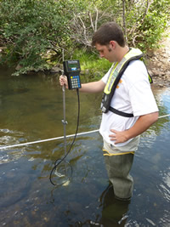
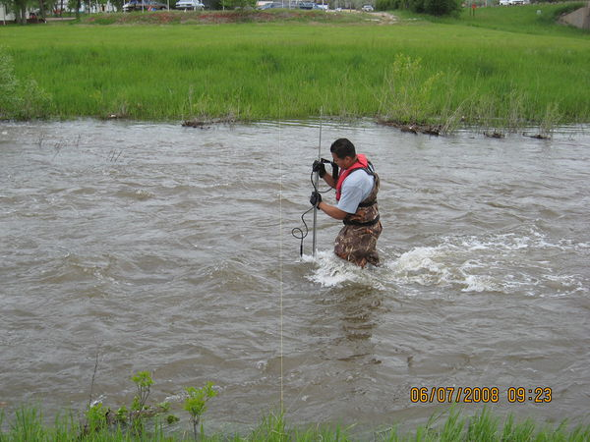
CURRENT METER METHOD
Price Current Meter
  In shallow water meter is mounted on a rod as the observer wades through the stream and notes down number of revolutions

Slide 7
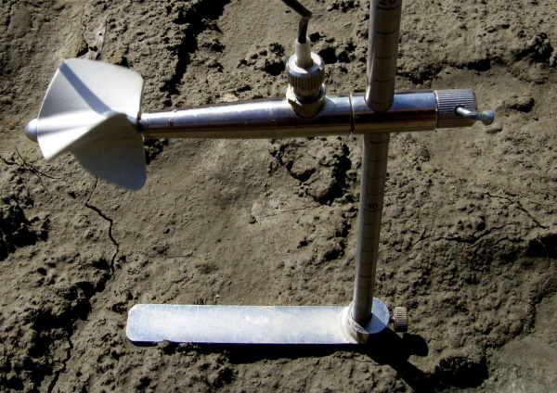
CURRENT METER METHOD
Propeller type Current Meter
  In this type a propeller rotates about a horizontal axis
  Contacting mechanism is same
  Sediment may entrap in the bearing
  All the measurement procedure remains the same
Contact Chamber
Wading Rod
Propellers
Foot Plate

Slide 8
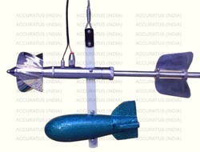
CURRENT METER METHOD
Propeller type Current Meter

Slide 9
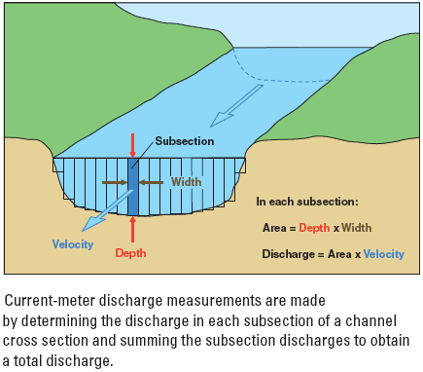
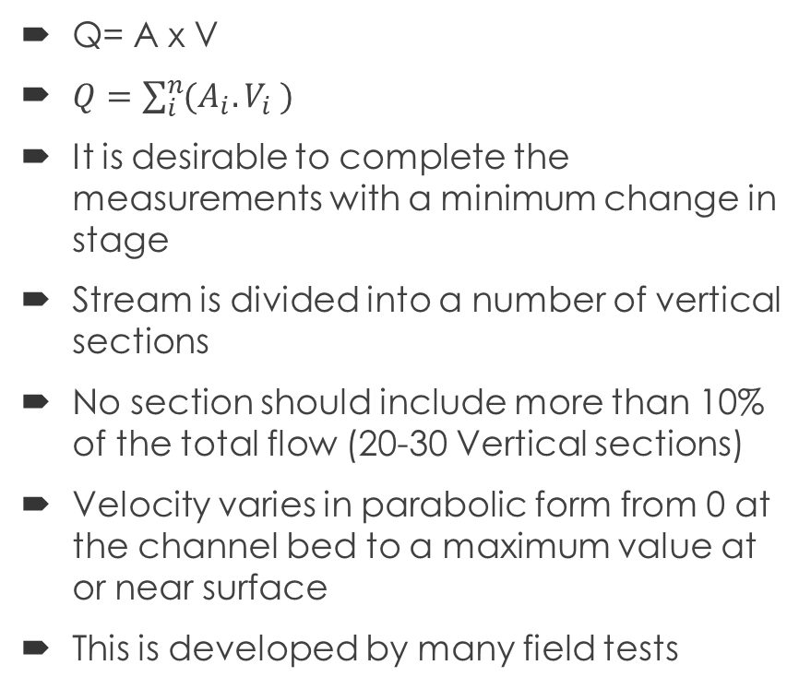
CURRENT METER MEASUREMENTS
Q= A x V
$Q=\sum_{i}^{n}{(A_{i}.V_{i} )}$
It is desirable to complete the measurements with a minimum change in stage
Stream is divided into a number of vertical sections
No section should include more than 10% of the total flow (20-30 Vertical sections)
Velocity varies in parabolic form from 0 at the channel bed to a maximum value at or near surface
This is developed by many field tests

Slide 10
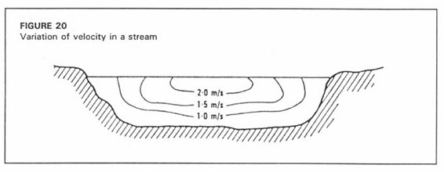
CURRENT METER MEASUREMENT
V
Velocity
Depth
Horizontal velocity Profile
Vertical velocity Profile

Slide 11
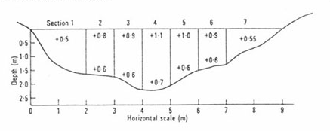
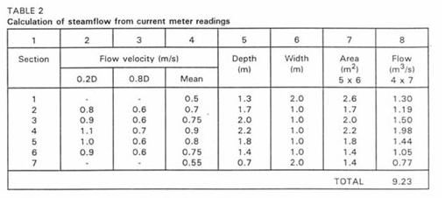
CURRENT METER MEASUREMENTS
Mean Velocity:
  Average of the velocities at 2 tenths and 8 tenths depth below water
  Or is equal to 6 tenths below the water surface
Velocity Measurements:
  Six-tenths depth (Shallow Flows)
  Two point method (Deep Flows)
  Three Point method (very deep flows)

Slide 12
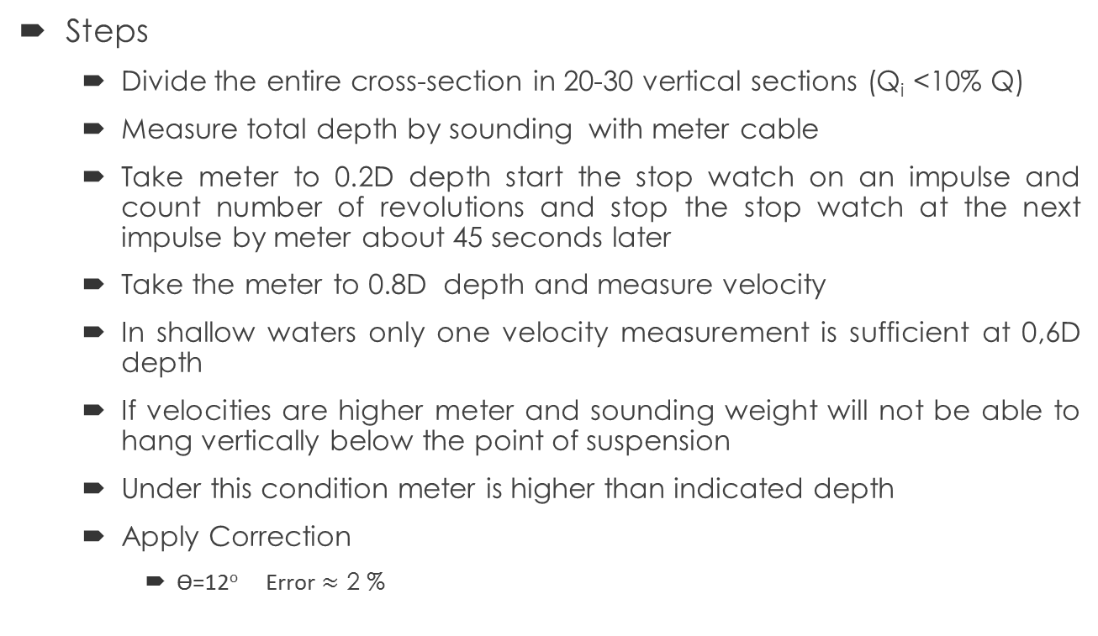
CURRENT METER MEASUREMENTS
Steps
  Divide the entire cross-section in 20-30 vertical sections (Q_{i} <10% Q)
  Measure total depth by sounding with meter cable
  Take meter to 0.2D depth start the stop watch on an impulse and count number of revolutions and stop the stop watch at the next impulse by meter about 45 seconds later
  Take the meter to 0.8D depth and measure velocity
  In shallow waters only one velocity measurement is sufficient at 0,6D depth
  If velocities are higher meter and sounding weight will not be able to hang vertically below the point of suspension
  Under this condition meter is higher than indicated depth
  Apply Correction
    Ѳ=12º Error $≈$ 2 %
Air Line
Ѳ
Water Surface
Stream bed
Stream having strong current

Slide 13
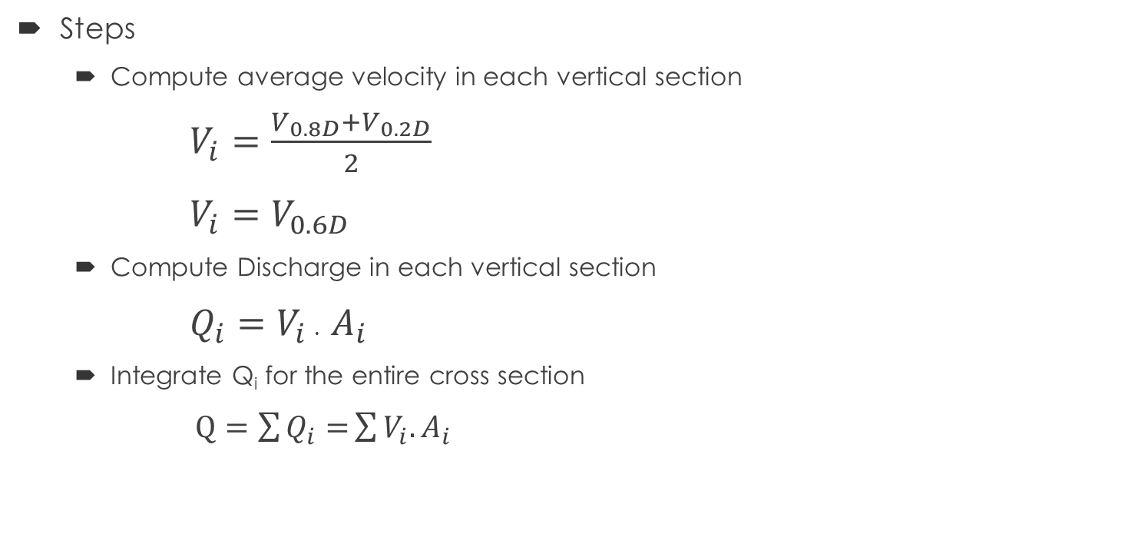
CURRENT METER MEASUREMENTS
Steps
  Compute average velocity in each vertical section
    $V_{i}=\frac{V_{0.8D}+V_{0.2D}}{2}$
    $V_{i}=V_{0.6D}$
  Compute Discharge in each vertical section
    $Q_{i}=V_{i}$ . $A_{i}$
  Integrate Q_{i} for the entire cross section
  $Q=\sum{Q_{i}=}\sum{V_{i}.A_{i}}$

Slide 14
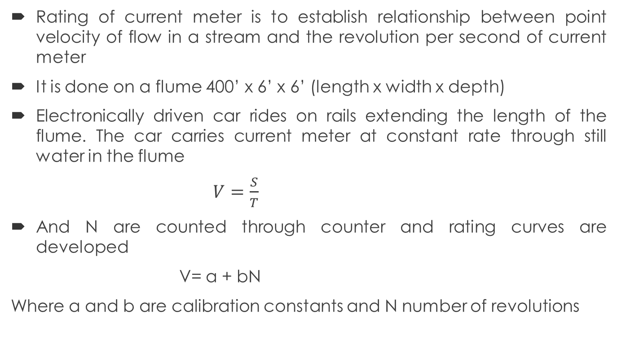
RATING OF CURRENT METER
Rating of current meter is to establish relationship between point velocity of flow in a stream and the revolution per second of current meter
It is done on a flume 400’ x 6’ x 6’ (length x width x depth)
Electronically driven car rides on rails extending the length of the flume. The car carries current meter at constant rate through still water in the flume
$V=\frac{S}{T}$
And N are counted through counter and rating curves are developed
V= a + bN
Where a and b are calibration constants and N number of revolutions
400’
6’
6’

Slide 15
NUMERICAL PROBLEM
Distance from bank (ft) | Depth (ft) | Meter Depth (ft) | Revolutions | Time (sec)
2 | 1 | 0.6 | 10 | 50
4 | 3.5 | 2.8 0.7 | 22 35 | 55 52
6 | 5.2 | 4.2 1 | 28 40 | 53 58
9 | 6.3 | 5 1.3 | 32 45 | 58 60
11 | 4.4 | 3,5 0.9 | 28 33 | 45 46
13 | 2.2 | 1.3 0.5 | 22 12 | 50 49
Compute the stream flow for the measurements of data given. Take the meter rating from equation with a= 0.1 and b=2.2 for v in ft/sec.
V = a + bN (ft/s)
a=0.1
b=2.2
Also report mean velocity and mean depth for the section.
0
2
4
6
9
11
13
15
17

Slide 16
NUMERICAL PROBLEM
V = a + bN (ft/s)
a=0.1
b=2.2
Distance from bank (ft) | Depth (ft) | Meter Depth (ft) | Revolutions | Time (sec) | N (Rev/Sec) | V (ft/sec) | V_{mean} (ft/sec) | Width of section (ft) | Area of section (ft²)
2 | 1 | 0.6 | 10 | 50
4 | 3.5 | 2.8 0.7 | 22 35 | 55 52
6 | 5.2 | 4.2 1 | 28 40 | 53 58
9 | 6.3 | 5 1.3 | 32 45 | 58 60
11 | 4.4 | 3,5 0.9 | 28 33 | 45 46
13 | 2.2 | 1.3 0.5 | 22 12 | 50 49
15 | 0.8 | 0.5 | 12 | 49
17 | 0 | 0 | 0 | 0
Q= a . V_{mean}

Slide 17
NUMERICAL PROBLEM
V = a + bN (ft/s)
a=0.1
b=2.2
Distance from bank (ft) | Depth (ft) | Meter Depth (ft) | Revolutions | Time (sec) | N (Rev/Sec) | V (ft/sec) | V_{mean} (ft/sec) | Width of section (ft) | Area of section (ft²)
2 | 1 | 0.6 | 10 | 50 | .2 | 0.54 | 0.54 | 2 | 2
4 | 3.5 | 2.8 0.7 | 22 35 | 55 52 | 0.40 0.67 | 0.98 1.58 | 1.28 | 2 | 7
6 | 5.2 | 4.2 1 | 28 40 | 53 58 | 0.53 0.69 | 1.36 1.62 | 1.44 | 2.5 | 13
9 | 6.3 | 5 1.3 | 32 45 | 58 60 | 0.55 0.75 | 1.31 1.75 | 1.53 | 2.5 | 15.75
11 | 4.4 | 3,5 0.9 | 28 33 | 45 46 | 0.62 0.72 | 1.47 1.68 | 1.57 | 2 | 8.8
13 | 2.2 | 1.3 0.5 | 22 12 | 50 49 | 0.44 0.24 | 1.07 0.64 | 0.85 | 2 | 4.4
15 | 0.8 | 0.5 | 12 | 49 | 0.24 | 0.64 | 0.64 | 2 | 1.6
Sum |  |  |  |  |  |  |  |  | 52.55
Q= a . V_{mean}
1.08
8.96
18.72
24.13
13.85
3.75
1.02
71.51

Slide 18

NUMERICAL PROBLEM
Results:
Q= 71.36 Cfs
V_{mean} = $\frac{\sum{Q_{i}}}{\sum{A_{i}}}$ =$\frac{71.36}{52.55}$ =1.36 ft/s
D_{mean} = $\frac{\sum{A_{i}}}{Total width}$ =$\frac{52.55}{17}$ = 3.09 ft

Slide 19
METHODS OF DISCHARGE MEASUREMENTS
By construction of regular structures
  Spillways, sluice gates, turbine gates
  Weirs and notches
  Flumes
  Highway culverts

Slide 20
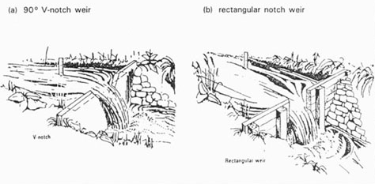
WEIRS AND NOTCHES
Weirs and notches

Slide 21
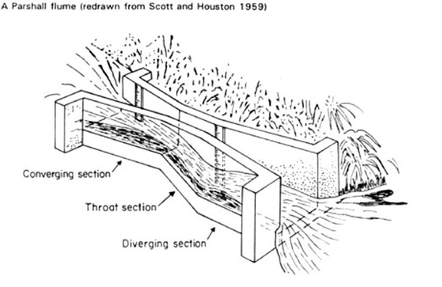
FLUMES
Flumes

Slide 22
DILUTION METHODS
Developed in 1863
Effective in flashy and turbulent hilly streams where current meters are difficult to use
Also for closed conduits such as penstocks, sewer pipelines current meter is not a measurement tool.
The method involves the injection of a chemical/ tracer into the flow and to obtain samples of the chemical water at a section d/s where dozing solution initially was mixed with the stream water
Basic Assumptions:
  Mixing of the tracer dye with river flow which can be better achieved in turbulent streams
Chief advantage:
  Precise knowledge of section geometry is not required
Disadvantage:
  Expensive for measuring large streams and special equipment is required

Slide 23
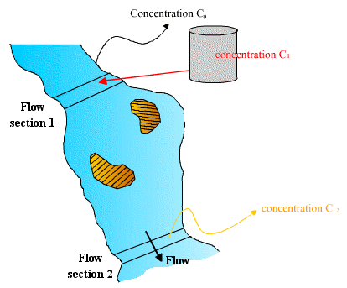
DILUTION METHOD

Slide 24
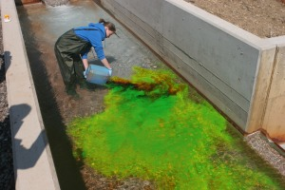
DILUTION METHOD

Slide 25
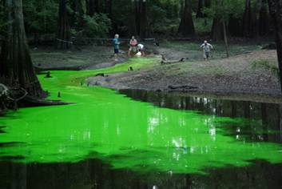
DILUTION METHOD

Slide 26
DILUTION METHODS
Reach Characteristics:
  No loss or gain of water in the reach
  Mixing must be complete at the sampling station
  Wide channels and reaches with bifurcation should be avoided
  Pools of dead water zones should be avoided
  A reach where turbulence is high is to be preferred, bends narrows and water falls are good aids for mixing.
Common Tracers used
  Salt solutions
  Radioactive tracers
  Fluorescent dyes

Slide 27
DILUTION METHOD FOR DISCHARGE MEASUREMENT
Injection methods:
  Sudden Injection
  Constant rate of injection
Sudden Injection
  In this method a known volume V of the dozing solution or tracer is added to the stream as rapidly as possible
  Sample are then taken at regular intervals of time and chemical concentration
  A curve is plotted between time and concertation called as Time-concentration curve

Slide 28

DILUTION METHOD FOR DISCHARGE MEASUREMENT
Sudden Injection
Concentration
$$Area=\int_{0}^{t}{C_{2}.dt}$$
Time

Slide 29
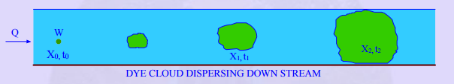
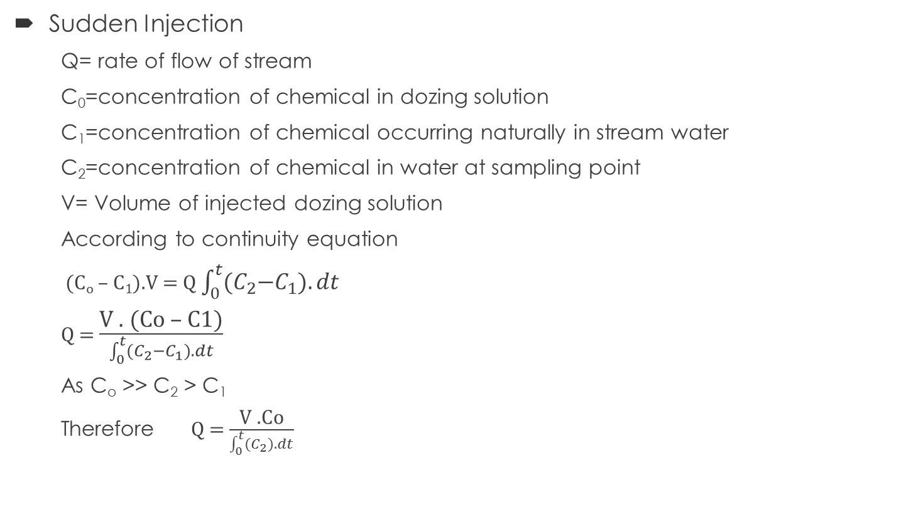
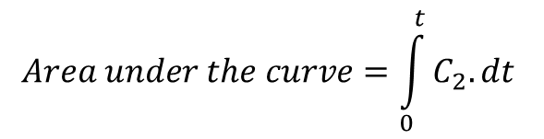
DILUTION METHOD FOR DISCHARGE MEASUREMENT
Sudden Injection
  Q= rate of flow of stream
  C₀=concentration of chemical in dozing solution
  C₁=concentration of chemical occurring naturally in stream water
  C₂=concentration of chemical in water at sampling point
  V= Volume of injected dozing solution
  According to continuity equation
  (C_{o} – C₁).V = Q $\int_{0}^{t}{{(C}_{2}−C_{1}).dt}$
  Q = $\frac{\text{V}\text{ . (}\text{Co}\text{ – }\text{C}\text{1)}}{\int_{0}^{t}{{(C}_{2}−C_{1}).dt}}$
  As C_{o} >> C₂ > C₁
  Therefore Q = $\frac{\text{V}\text{ .}\text{Co}}{\int_{0}^{t}{{(C}_{2}).dt}}$
C_{o} >> C₂ > C₁
$$Area under the curve=\int_{0}^{t}{C_{2}.dt}$$

Slide 30
DILUTION METHOD FOR DISCHARGE MEASUREMENT
Sudden Injection
Assumptions
  There is no loss of tracer between the injection and sampling section
  Area under the curve is same at different points of the sampling cross-sections
Advantages
  Minimum amount of solution is required
  More economical as continuous injection is not required
  Less sensitive to the position of the sampling station
Disadvantage
  Sampling and analysis for this method is rigorous

Slide 31
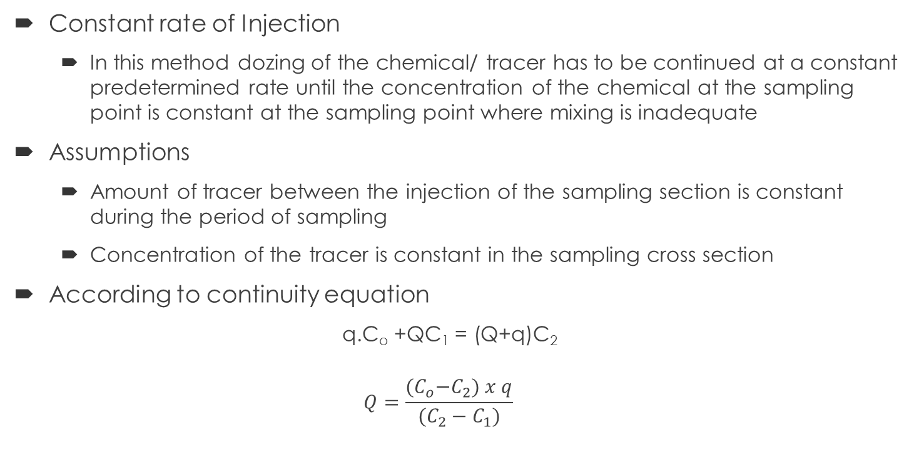
DILUTION METHOD FOR DISCHARGE MEASUREMENT
Constant rate of Injection
  In this method dozing of the chemical/ tracer has to be continued at a constant predetermined rate until the concentration of the chemical at the sampling point is constant at the sampling point where mixing is inadequate
Assumptions
  Amount of tracer between the injection of the sampling section is constant during the period of sampling
  Concentration of the tracer is constant in the sampling cross section
According to continuity equation
  q.C_{o} +QC₁ = (Q+q)C₂
  $$Q=\frac{{(C}_{o}−C_{2}) x q}{(C_{2}−C_{1})}$$
q= Rate of injection
N= Dilution Ratio for the Stations
C₃ =Concentration of chemical in stations

Slide 32
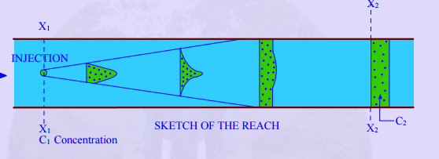

DILUTION METHOD FOR DISCHARGE MEASUREMENT
q= Rate of injection
N= Dilution Ratio for the Stations
C₃ =Concentration of chemical in standard solution
According to continuity equation
  q.C_{o} +QC₁ = (Q+q)C₂
  $$Q=\frac{{(C}_{o}−C_{2}) x q}{(C_{2}−C_{1})}$$
  Since C_{o} >> C₂ and C₂ >>C₁
  $Q=\frac{C_{o}. q}{C_{2}}$
  The solution is diluted by a known dilution ratio “N” to give a standard solution of concentrations C₃ to use in measuring techniques
  So for low concentration
  $Q=\frac{N.C_{3}}{C_{2}}.q$

Slide 33
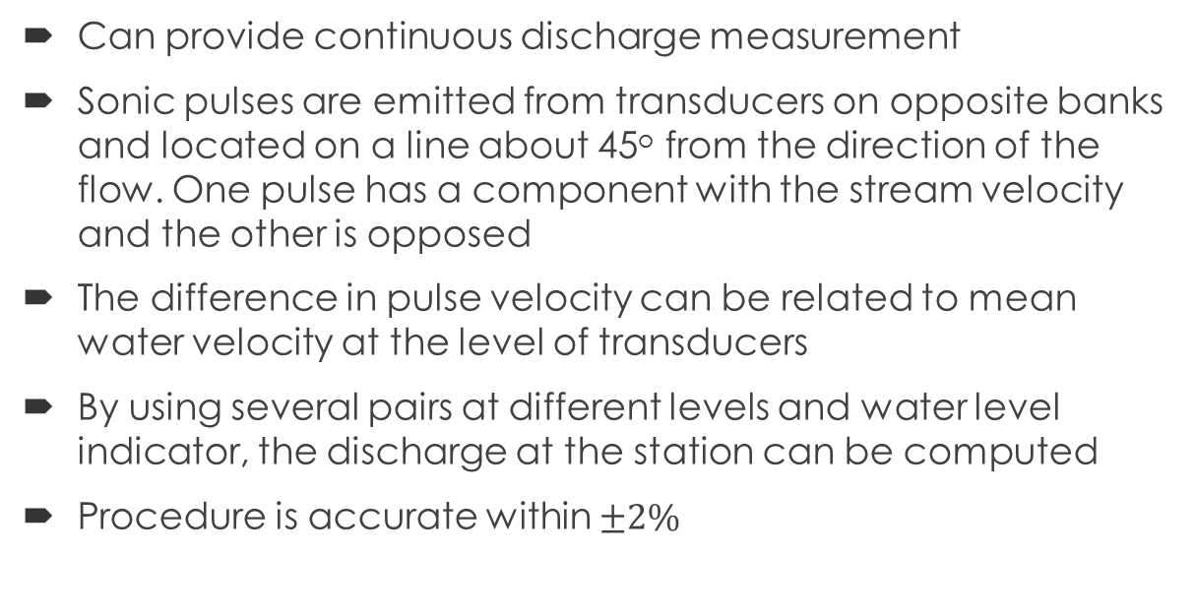
ULTRASONIC METHOD
Can provide continuous discharge measurement
Sonic pulses are emitted from transducers on opposite banks and located on a line about 45º from the direction of the flow. One pulse has a component with the stream velocity and the other is opposed
The difference in pulse velocity can be related to mean water velocity at the level of transducers
By using several pairs at different levels and water level indicator, the discharge at the station can be computed
Procedure is accurate within $±2\%$
Transducer
45º
L
V
Transducer

Slide 34

ULTRASONIC METHOD
$t=\frac{S}{V}$
$t_{1}=\frac{L}{C+V_{p}}$ $\frac{1}{t_{1}}=\frac{C+V_{p}}{L}$ Where C is the velocity of ultrasonic waves
$t_{2}=\frac{L}{C−V_{p}}$ $\frac{1}{t_{2}}=\frac{C−V_{p}}{L}$
$\frac{1}{t_{1}}−\frac{1}{t_{2}}=\frac{C+V_{p}}{L}−\frac{C−V_{p}}{L}$ = $\frac{2V_{p}}{L}$ = 2VcosѲ/L
SINCE V_{p} = V cosѲ
$V=\frac{L}{\text{2}\text{cos}\text{Ѳ}}(\frac{1}{t_{1}}−\frac{1}{t_{2}})$
Transducer
45º
L
V
Transducer

Slide 35
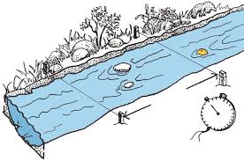
FLOAT METHOD

Slide 36
BOATING METHOD
A boat traverses the stream at constant speed on a course normal to the flow
A special meter operates continuously and indicates the instantaneous velocity
Echo-sounder measures the cross-section of the stream during the traversing (30-40 points measurements)
Several traverses are made and averaged
Using this velocity and cross section data discharge is calculated for the stream

Slide 37
STAGE-DISCHARGE RELATIONS
Rating Curve
Dispersion of the measured data should be <2% (standard deviation)
Larger dispersion indicates
  Control shifts more or less continuously (scour, deposition and growth of vegetation)
  Water surface slope varies at the control as a result of backwater
  Measurements are not carefully made

Slide 38
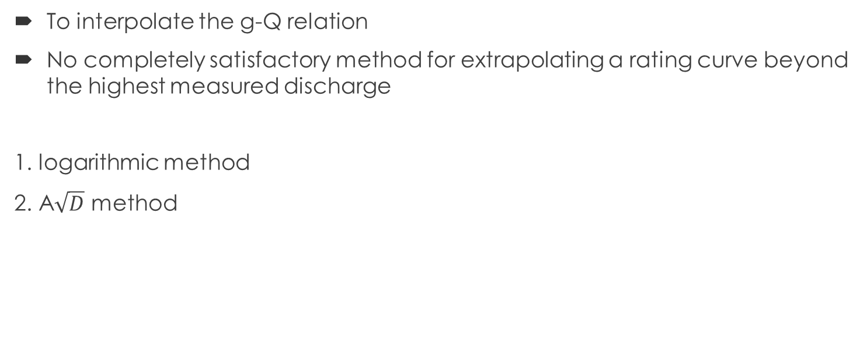
EXTENSION OF RATING CURVE
To interpolate the g-Q relation
No completely satisfactory method for extrapolating a rating curve beyond the highest measured discharge
1. logarithmic method
2. A$\sqrt{D}$ method

Slide 39
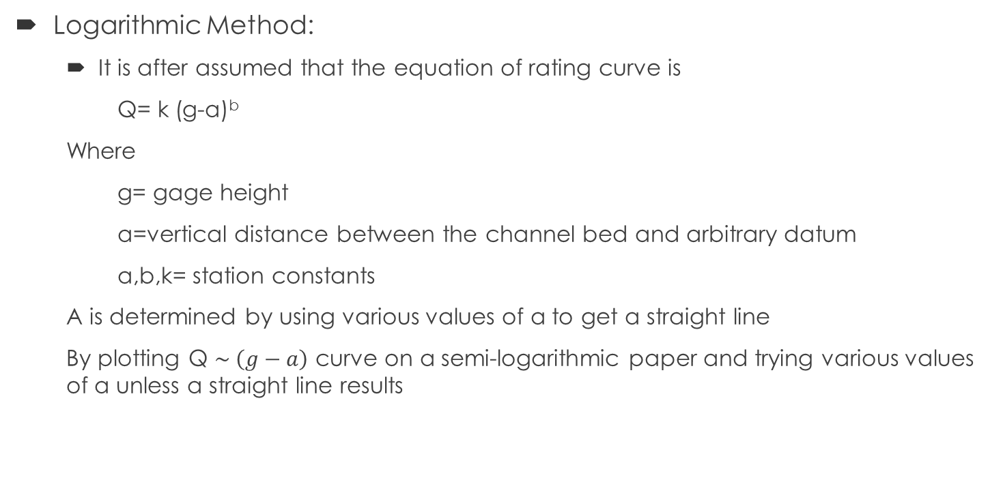
EXTENSION OF RATING CURVE
Logarithmic Method:
  It is after assumed that the equation of rating curve is
  Q= k (g-a)^{b}
  Where
  g= gage height
  a=vertical distance between the channel bed and arbitrary datum
  a,b,k= station constants
  A is determined by using various values of a to get a straight line
  By plotting Q $\sim \left(g−a\right)$ curve on a semi-logarithmic paper and trying various values of a unless a straight line results

Slide 40

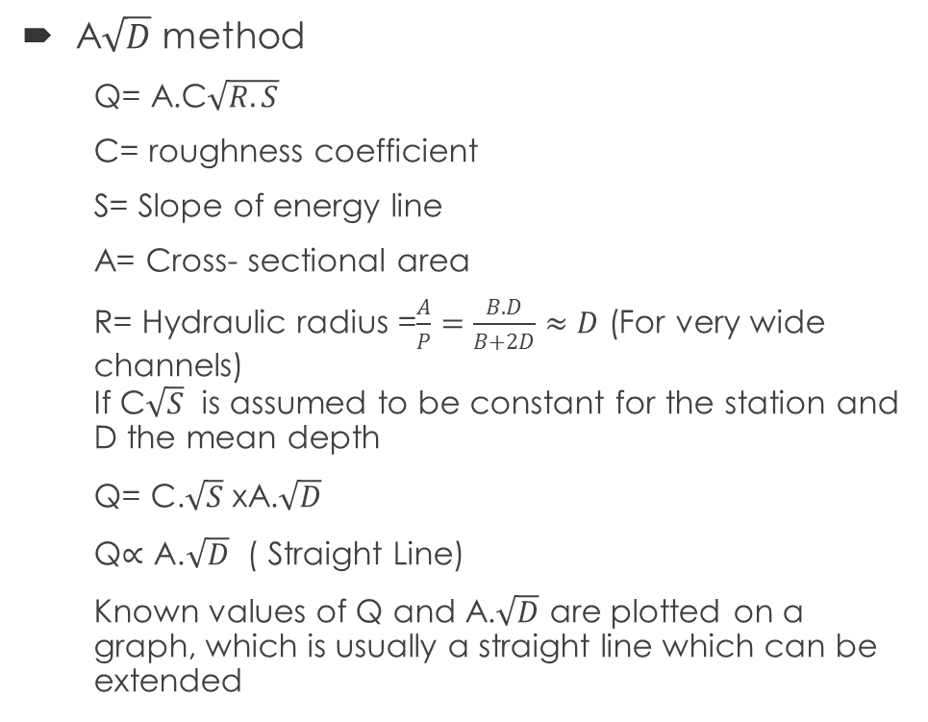
EXTENSION OF RATING CURVE
Q
A$\sqrt{D}$ method
  Q= A.C$\sqrt{R.S}$
  C= roughness coefficient
  S= Slope of energy line
  A= Cross- sectional area
  R= Hydraulic radius =$\frac{A}{P}=\frac{B.D}{B+2D}≈D$ (For very wide channels)
  If C$\sqrt{S}$ is assumed to be constant for the station and D the mean depth
  Q= C.$\sqrt{S}$ xA.$\sqrt{D}$
  Q$∝\text{A}\text{.}\sqrt{D}$ ( Straight Line)
  Known values of Q and A.$\sqrt{D}$ are plotted on a graph, which is usually a straight line which can be extended
A$\sqrt{D}$
g

Slide 41
PLANNING & STREAM FLOW NETWORK
Types of stations
  Operational stations ( stream flow forecasting, project operation and water allocation)
  Special Stations ( to secure data for project investigation, special studies on research)
  Basic data Stations ( data for future use)
Factors affecting the planning
  Regional development
  Hydrologic characteristics of the region
  Probable information needed ( design of hydraulic structure)
    1 gage in developed region 26km²
    1 gage in developing region 260km²

Slide 42
UNITS OF STREAM FLOW
Discharge units
  Cusec = ft³/s =second-ft = cfs
  Cumecs= m³/s
Volume units
  Cubic ft =cft
  Sfd = cfs- day (vol. of water collected in one day at a rate of 1 cusec)
  Sfh
  Acre-ft ( vol. of runoff when it is spread over an acre of area and 1’ depth)
  1 acre-ft = 43560 ft³
  Inches or cm of runoff (volume when 1” water is spread throughout the area)
  Millions of meter cube= ??? Sfd?
  Water year = 1st oct-30th sep

