Slide 1
Surveying & Measurement
Distance Measurement

Slide 2
Introduction
One of the most fundamental surveying operations is the measurement of horizontal distance between two points on the surface of the earth.
There are two basic methods used:
  Direct.
  Indirect.

Slide 3
Introduction
Direct linear measurements are methods used for determining horizontal distances with a tape (or chain) and/or with an electronic distance measuring instrument.
In indirect methods, the transit and stadia or theodolite and stadia are used.

Slide 4
Horizontal Distance
^{H}AB
A
B

Slide 5
Vertical Distance
A
^{V}AB
B

Slide 6
Slope Distance
A
^{S}AB
B

Slide 7
Cubits
Distance is one of the most basic engineering measurements
Early measurements were made in terms of the dimensions of the body
Cubits - the distance between the tip of your middle finger to the elbow.
Typically to measure cords and textiles
  (another measure was 24 digits or 6 palms)

Slide 8
Fathom
Fathom - distance between the tips of your middle finger when your arms are outstretched
The name comes from the Danish faedn, "outstretched arms."

Slide 9
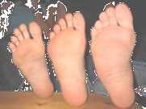
Foot
Foot distance from the tip of a man’s big toe to the heel
Rod - the sum of the lengths of the left feet of 16 men (16.5 - 24 ft)

Slide 10
Approaches
Approaches in measuring horizontal distance
  Pacing
  Optical rangefinders
  Odometers
  Tachometry
  Taping or Chaining
  Electronic Distance Measurement (EDM)
  Global Positioning System (GPS)

Slide 11
Pacing
A person can determine their pace by counting the number of paces necessary to walk a distance that has been previously measured
A pace is defined as one step
A stride is consider two steps

Slide 12
Chaining
The most common method used in determining or laying off linear measurements for construction surveys, triangulation base lines, and traverse distances is often referred to as chaining.
For centuries engineers have measured distances with ropes, lines, or cords.

Slide 13
Chaining
The term chaining is a carry–over from the time when the Gunter chain was used (1600’s-1900’s)
The 66 foot chain is made of 100 links
7.92 inches in length.
In 1785 U.S. a federal law stated that all government surveys must be done with a Gunter's chain

Slide 14
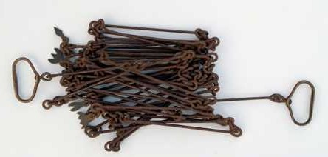
Gunter Chain
The surveyor's chain was called Gunter's, after its inventor, the English mathematician and astronomer Edmund Gunter (1581-1626).

Slide 15
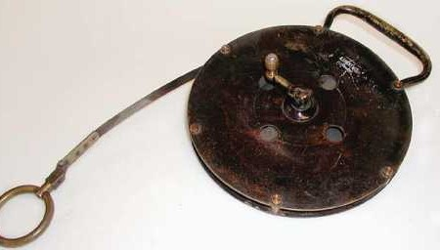
Taping
Accurate surveyors' tapes made of steel or a steel alloy with a typical length of 100 feet or 100 meters were used for surveying distances.
1870’s surveyor’s steel tape

Slide 16
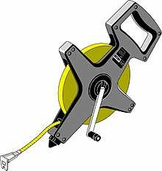
Taping
For very accurate measurements, the temperature of the tape must be taken into account, as well as the tension of the pull.
Each Steel Tape had its own temperature and tension coefficient, which was used to correct each measurement.
Non-metallic tapes are now common that are woven from synthetic yarns.

Slide 17
Accuracy
Pacing; 1/50 to 1/200; Reconnaissance
Odometer; 1/200; Reconnaissance
Taping; 1/1,000 to 1/5,000; Land surveys
• EDM; ±0.04 to 1/300,000; All types of surveying

Slide 18
Duties of Chaining/Taping Members
The smallest chaining group could consist of only two people, one at each end of the tape.
The person ahead, holding the zero end, is called the head chainman (back man).
The other person is known as the rear chainman (front man).

Slide 19
Taping Process
Site inspection and setup
  A preliminary investigation of the field site is undertaken to map out a measurement strategy, and to identify and locate initial starting and fixed points
  Range poles may be placed to help define the measurement line
  Field notes should be taken for later reference (e.g. date, weather, temperature, potential obstructions, topography etc.)

Slide 20
Plumb-bob and Peg
A plumb-bob is used to locate the measurement point on the tape vertically above a fixed marker, or to place taping pins to mark tape lengths.
Each end point of a measurement is marked by placing the plumb-bob string over the tape.
Pegs is set out to mark the positions.

Slide 21
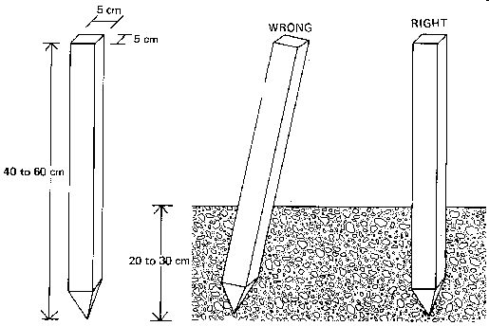
Peg

Slide 22
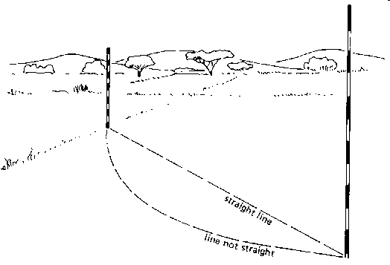
Site Setup
Straight Line
A straight line is the shortest distance between two points on a map or between two points on the field.

Slide 23
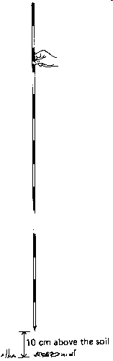
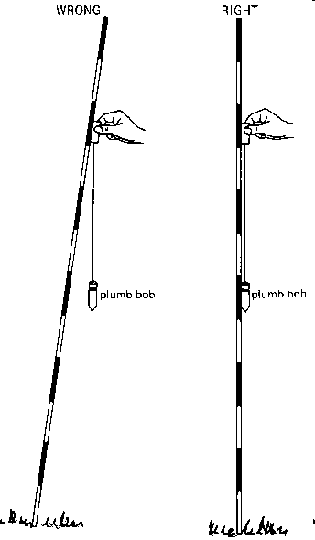
Site Setup
Placing Ranging Pole
The correct way to hold a ranging pole is to keep it loosely between thumb and index finger, about 10 cm above the soil

Slide 24
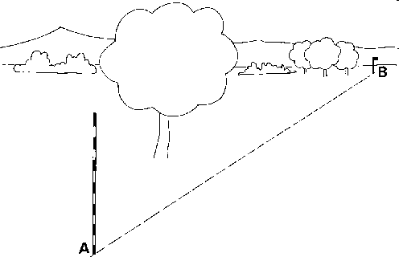
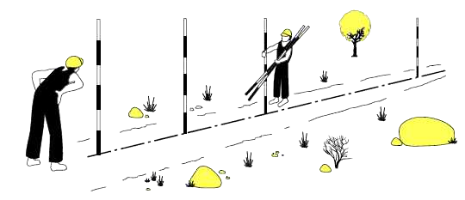
Site Setup
Long Distance Straight Line

Slide 25
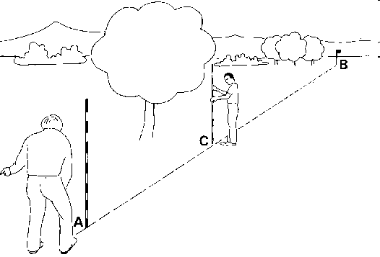
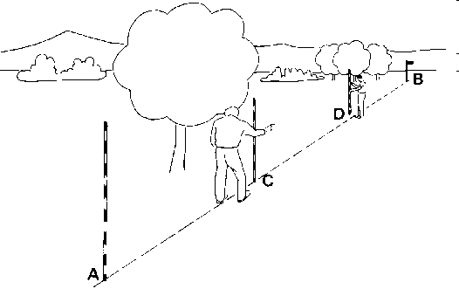
Site Setup
Long Distance Straight Line

Slide 26
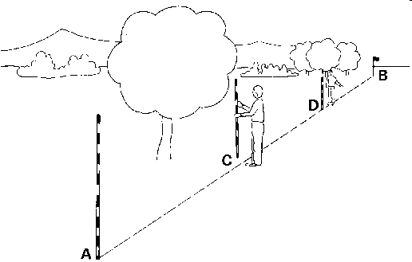
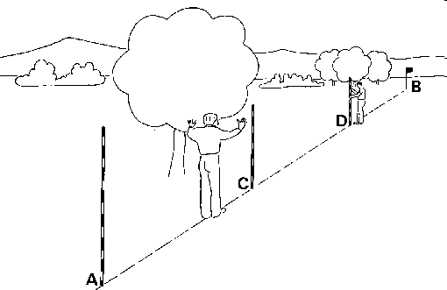
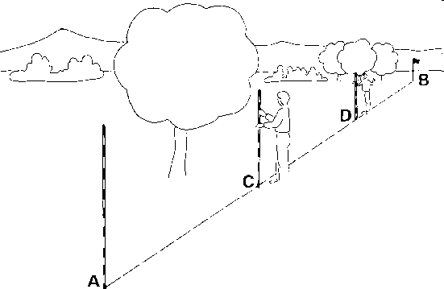
Site Setup
Long Distance Straight Line

Slide 27
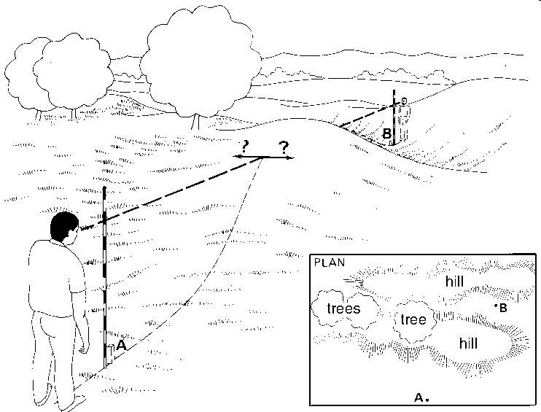
Site Setup
Over A Ridge or A Hill

Slide 28
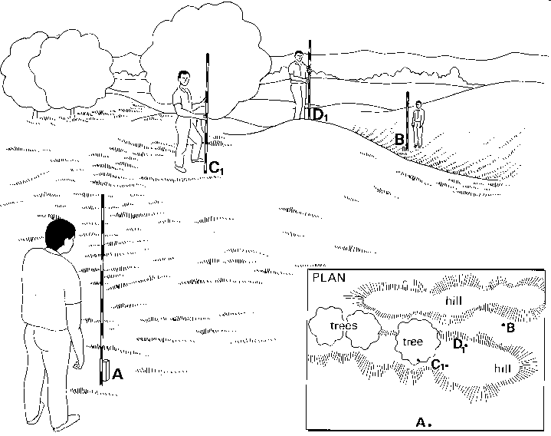
Site Setup
Over A Ridge or A Hill

Slide 29
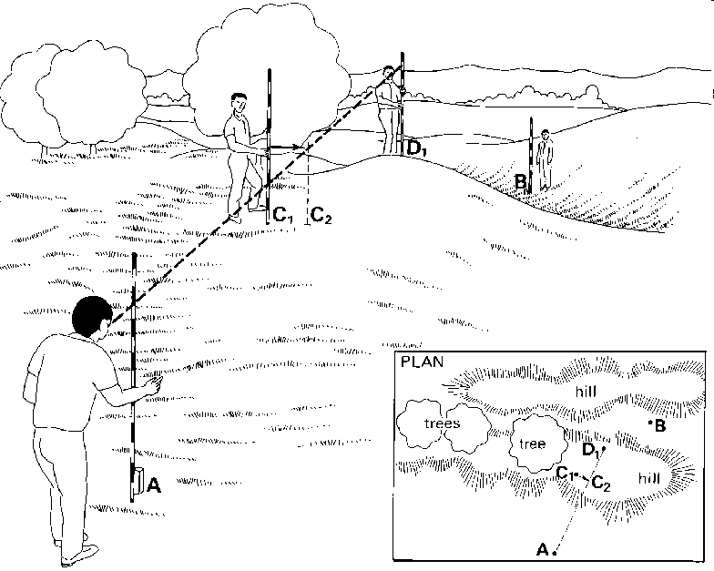
Site Setup
Over A Ridge or A Hill

Slide 30
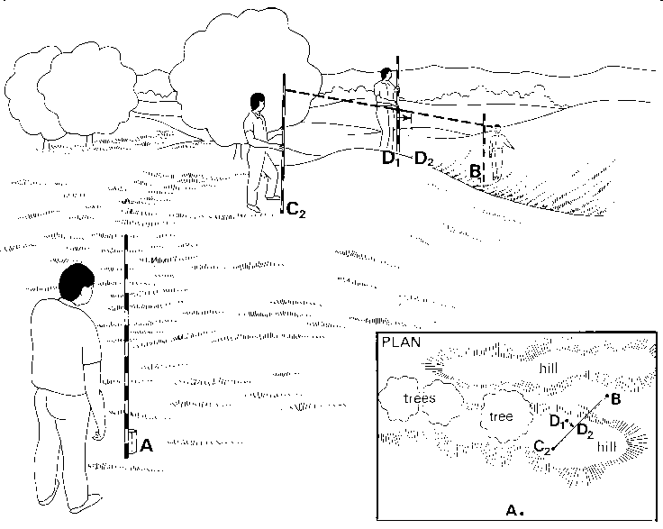
Site Setup
Over A Ridge or A Hill

Slide 31
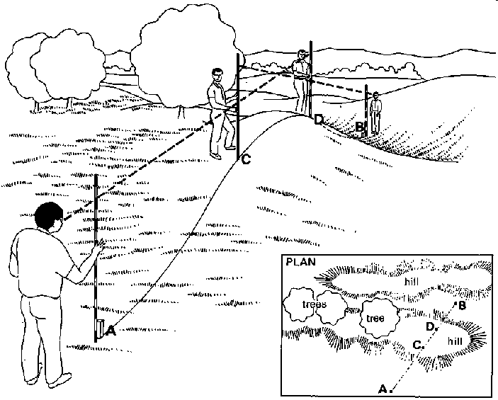
Site Setup
Over A Ridge or A Hill

Slide 32
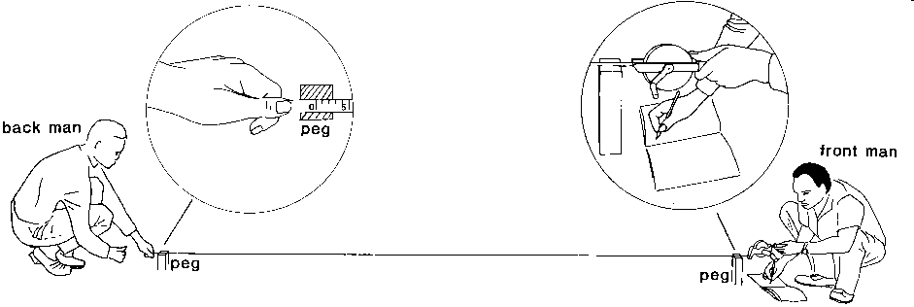
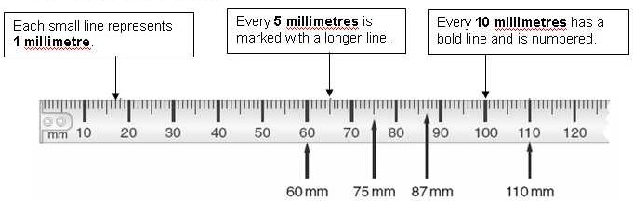

Measuring Distance
Short Distance
Tip
Each small division represents 1mm. So if the nail is positioned two small divisions after 7280 mm, it is marking 7282 mm.

Slide 33
Measuring Distance
Long Distance
The head chainman also acts as the recorder also reads and records the temperature of the tape.
The rear chainman is responsible for keeping the tape in alignment.

Slide 34
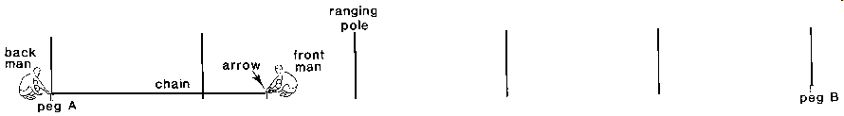

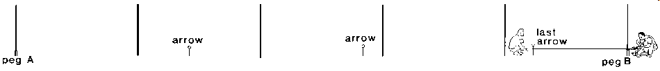
Measuring Distance
Long Distance

Slide 35
Stretcherman
For more precise taping, a three-man party is essential.
In addition to the head and rear chainmen, a stretcherman is added.
The duties of the stretcherman are to apply and to maintain the correct tension on the tape while the chainmen do the measuring.

Slide 36
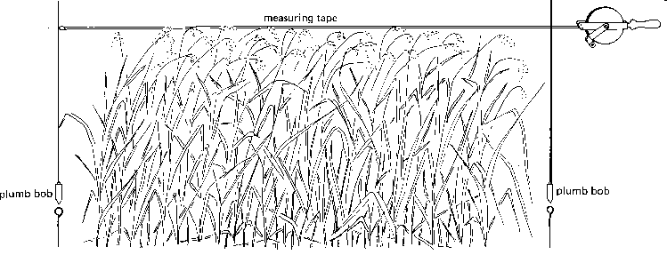
Measuring Distance
in A Tall Growing Crop

Slide 37
Taping over Level Ground
If the taping is done over level ground where there is no underbrush, the tape can rest on the ground
if the distance being measured is greater than a tape length, it is necessary to mark the terminal point with a range pole.

Slide 38
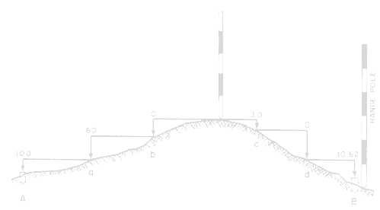
Breaking Tape
The term breaking tape is used to describe the procedure for measuring directly horizontal distance on sloping ground, or through obstacles that do not permit the use of a full tape length.

Slide 39
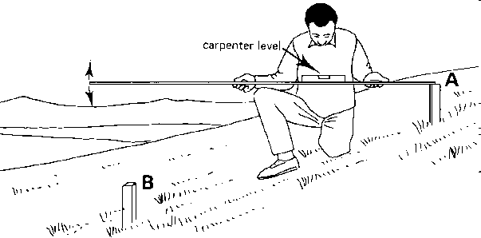
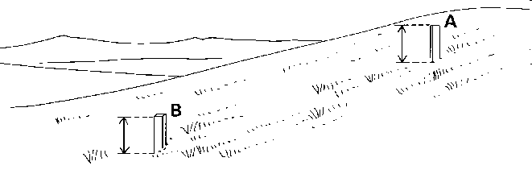
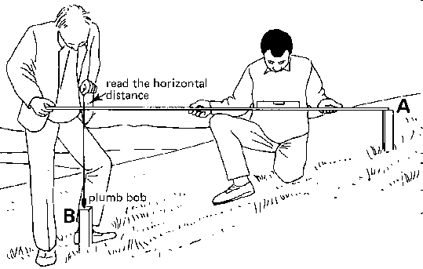
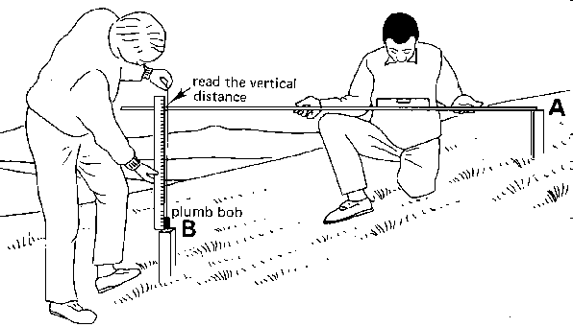
Measuring Distance
in Steep Sloping Areas

Slide 40
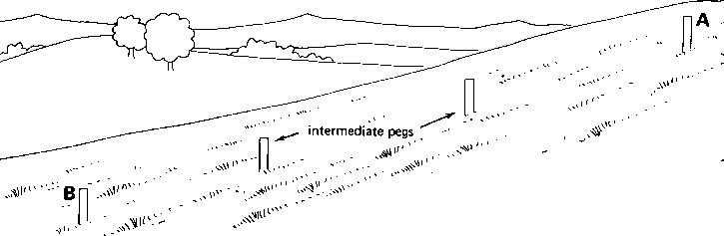
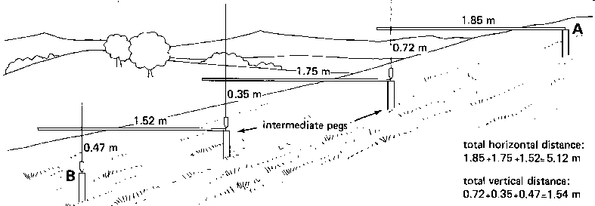
Measuring Distance
in Steep Sloping Areas

Slide 41
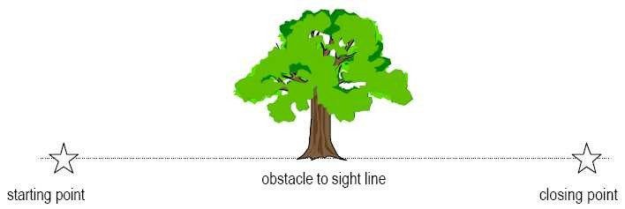
Taping around Obstacles (1)
Where an obstruction (e.g. boulder, tree, etc.) lies on the measurement line, it will be necessary to break the tape around the obstacle.

Slide 42

Taping around Obstacles (2)
3
σ
β
1
2
4
5
Horizontal angles σ and β are used to transform the resulting horizontal lengths to an equivalent horizontal length along the measurement line

Slide 43

Taping around Obstacles (3)
Horizontal angles are measured using a compass or are calculated using the cosine law.
C
B
σ
A

Slide 44
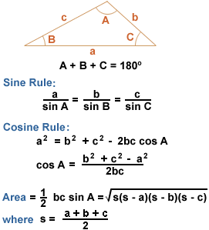
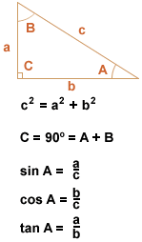
Review Basic Trigonometry

Slide 45
Making Tape Corrections (1)
Off all the measurement method, taping is probably the least automated and most susceptible to personal and natural errors.
The basic error arise due to
  defect in the tape
  natural error due to weather conditions
  human errors resulting in tape reading errors

Slide 46
Making Tape Corrections (2)
A tape supported only at the ends has a sag in it.
When it indicates 100.00 m, actually the distance measured is less.
A steel tape will be longer when it is warm than when it is cold.

Slide 47
Making Tape Corrections (3)
All tapes are graduated under controlled conditions of temperature and tension.
When they are taken to the field, these conditions change.
The tape, regardless of the material used to make it, will be either too short or too long.

Slide 48
Making Tape Corrections (3)
For low accuracy surveys, the amount of error is too small to be considered.
As accuracy requirements increase, variations caused by the temperature and sag must be computed and used to correct the measured distance.
Tape corrections are typically relatively small (i.e. <1% of the measured distance), but still significant!

Slide 49
Standardisation (1)
Taping cannot be more accurate that the accuracy to which the tape is standardised.
The tape should be standardised by appropriate authority.
The tape will be return with certificate on true length and standard condition of temperature and tension.

Slide 50
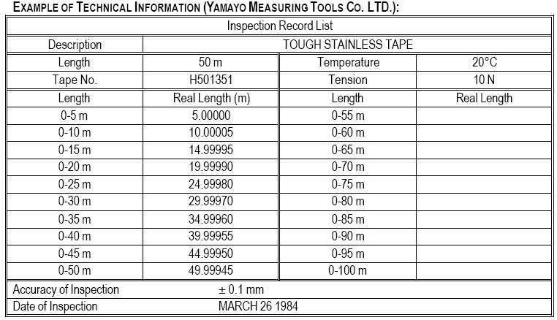
Standardisation (2)

Slide 51

Incorrect Tape Graduation (1)
actual measurement distance may be shorter (l<l’) or longer (l>l’) than measured due to errors in tape graduation
The correction is assumed proportional to the tape length and can be applied to the total measured length
Correction factor C_{L}

Slide 52
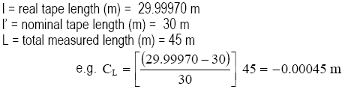
Incorrect Tape Graduation (2)

Slide 53
Thermal Expansion (1)
Tapes have been standardised (calibrated) to a specific temperature.
Actual measurement distance may be shorter (T<To) or longer (T>To) than measured due to thermal expansion of the tape.
Correction uses the air temperature during taping and may be applied to the total measured length.

Slide 54
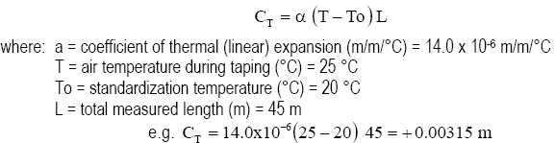
Thermal Expansion (2)

Slide 55
Pull/Tension (1)
Tapes have been standardised to a specific tension/pull.
Actual measurement distance may be shorter (P<Po) or longer (P>Po) than measured depending on the amount of tension applied to the tape.
Correction uses the tension applied during taping and may be applied to the total measured length.

Slide 56
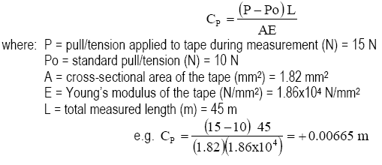
Pull/Tension (2)

Slide 57
Sag (1)
•
The actual measurement distance may be shorter than the measured length due to sagging of the tape because of its weight or the wind
Sagging is a function of the pull/tension applied to the tape, and the support conditions
Typically, the tape is supported at the ends only, but may also be supported throughout or at midpoints
•
•

Slide 58
Sag (2)
Correction is applied to each individual unsupported length, and the total sag correction (CST) is the sum of the sag corrections for each unsupported tape length used to make up the measurement line.

Slide 59
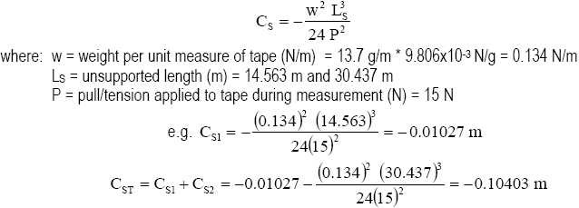
Sag (3)

Slide 60
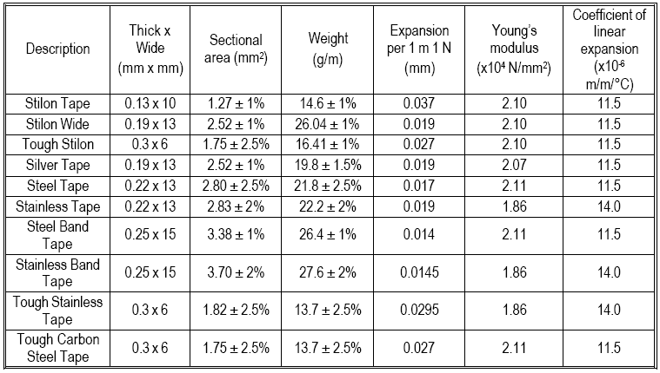
Specifications

Slide 61
Slope (1)
Sloping tape with levelling, actual measurement distance is shorter than the measured tape length.
Elevation change across the measurement length is used to correct measured length to actual distance.
Elevation change is measured using levelling.

Slide 62
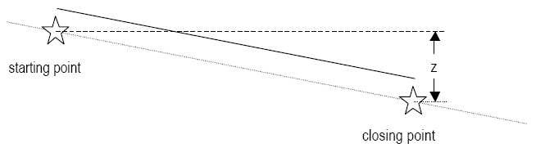
Slope (2)
Correction factor C_{θ}

Slide 63
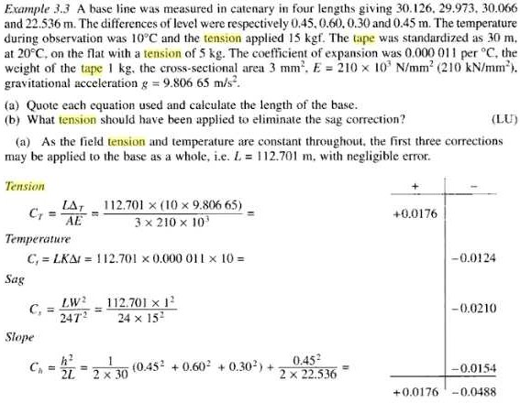

Slide 64
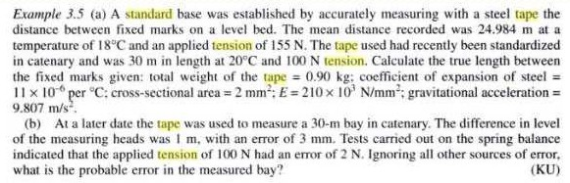
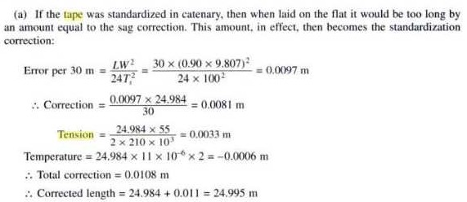

Slide 65
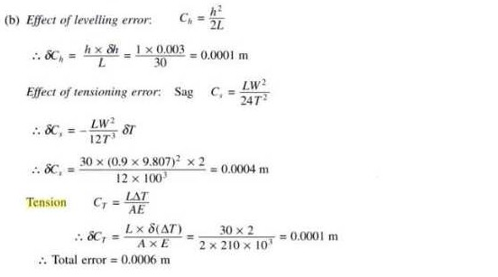

Slide 66
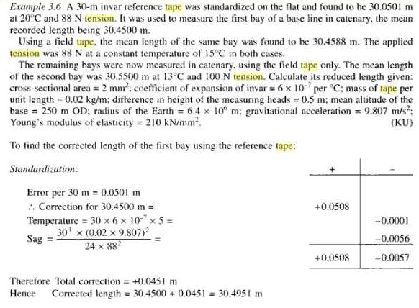

Slide 67
TOPIC
Distance Measurement (from introduction)
Notes:
Mention about the greater area of land when purchase on the sloping ground.
Measurement should be made very carefully as there is no means of checking if it is accurate or not?

Slide 68
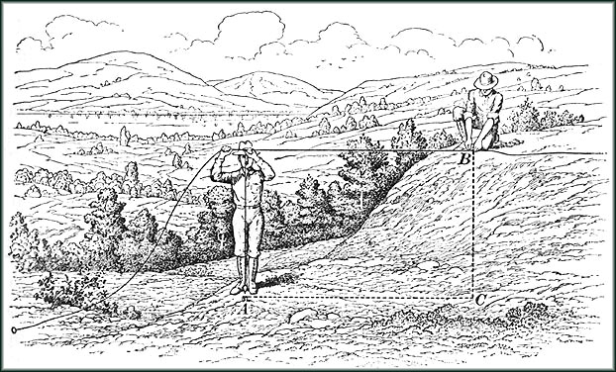
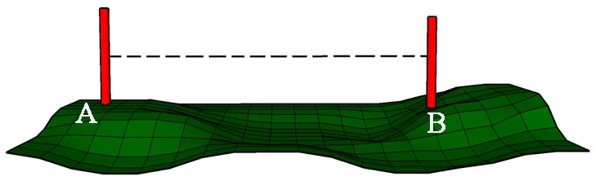
Linear measurement- Basics
One of the basic function in surveying
  Always horizontal not sloping distance
  No way to check the error other than remeasuring
Horizontal distance is correct
B
Inclined distance AB is not correct
A
Notes:
Mention about the greater area of land when purchase on the sloping ground.
Measurement should be made very carefully as there is no means of checking if it is accurate or not?

Slide 69
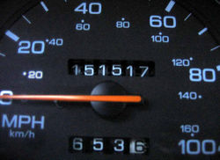









Linear measurement methods
Methods
Direct measurements
By optical means
Electronic methods

Slide 70
Direct measurements
Instruments such as
  Pacing
  Passometer
  Pedometer
  Odometer or Speedometer
Rough methods for preliminary survey
Check of large mistakes in measurement made by more precise method
Unsuitable in irregular and sloping ground
Precision – 1/50 to 1/200

Slide 71

Taping / Chaining
Chaining or taping carries same meaning
  Use of either chain or tape.
  One of the accurate method of direct measurements
  This method is basis for most surveying.
  Precision
    1/1000 to 1/5000 (ordinary land survey)
Use of chain or tape
  Chain (Early 1600s)
  Steel tape in use by early 2000s
  Tape is very common nowadays.

Slide 72








Instruments for chaining/taping
Chain/tape
Arrows
pegs
Ranging rods
Plumb bob
Hand level

Slide 73

Instruments for chaining/taping
Contd….
Arrows
  10 arrows
Pegs
  Station position
  Terminal points of survey line

Slide 74
Instruments for chaining/taping
Contd….
Ranging rods
  Used to range intermediate points on survey line
  Length 2 m ( very common) or 3 m
  Bands of 20 cm painted alternate colour( red & white, black & white)
Ranging poles
  Similar to ranging rod but big in size
  Used in case of long lines
  Used to range intermediate points on survey line

Slide 75

Instruments for chaining/taping
Contd….
Plumb bob
  Verticality of ranging pole
  Transferring the points to ground
  Also used for centring purpose in other surveying methods.

Slide 76
Different types of chain/tape
Chain (Absolute equipment at present)
  Metric chain (available in 5,10,20 meter)
  Gunter’s or surveyor’s chain (66 ft of 100 links)
  Engineer’s chain (100 ft of 100 links)
  Revenue chain (33 ft of 16 links)
  Steel band or band chain ( 20 or 30 m)

Slide 77



Different types of chain/tape
Contd….
Tape
  Cloth or Lenin tape
  Metallic tape
  Steel tape
  Invar tape (Alloy of nickel 36% & steel)
Cloth Tape
Steel Tape
Linen Tape
Metallic Tape

Slide 78
Ranging
When the length of survey line is greater than chain or tape length
  Process of establishing intermediate points
Methods
  Direct Ranging
  Indirect Ranging
Intermediate points
> one tape length
A
B

Slide 79
Direct ranging
Direct ranging
  When two end points are intervisible
  Either by eye or through optical instruments such as
    Line ranger
    Theodolite
  Code of signals used to direct assistant

Slide 80
Indirect ranging
Indirect ranging
  When two end points are not intervisible
  With the aid of two intermediate points very near to the line
M
N
A
B
M
N
A
M₃
B
N₃
M₂
N ₂
N₁
M₁

Slide 81
Chaining/taping over sloping ground
Methods
  Direct method or method of stepping
  Indirect method
    With the aid of vertical angle measurement
    With the aid of difference in level measurement
    Hypotenusal allowance

Slide 82
Chaining/taping over sloping ground
Contd….
Direct method or stepping method
  Convenient to proceed down-hill
  Tape shall be horizontal
  Sufficient pull to avoid sag
  Lengths of steps inversely proportion to degree of slopes.
l₁
A
l₂
l₃
l₄
D = (l₁+l₂+l₃+l₄)
B

Slide 83




Chain surveying
What is chain surveying?
Principle of chain surveying
  Triangulation
Survey stations
  Main station (A, B, C,…E)
  Subsidiary stations (F, G, H)
  Marking of stations
Survey lines
  Main survey lines
  Base lines
  Check lines
  Tie lines

Slide 84
Survey stations & survey lines
Station
  Mutually visible
Survey lines
  Few as far as possible
  Must have one base line
  Pass through level ground
  Form well-conditioned triangle
  Sufficient check line
Short offset
Should not pass through obstacle
Should fall within the boundaries

Slide 85
Chain surveying (field/office work)
Equipment
  Chain/Tape (>30 m)
  10 Arrows
  Raging rods
  A tape ( 10 m or 20 m )
  Cross staff or Optical square
  Field book, pencil
  Plumb bob
  Pegs, wooden hammer, chalks

Slide 86
Field work
Field work consists of three steps
  Reconnaissance
  Marking and fixing survey stations
  Running survey lines
Reconnaissance
  Walkover survey with the view of principle of surveying
  Reference sketch
  Thinking of possible problem and their solution in actual survey

Slide 87

Conventional symbols

Slide 88

Conventional symbols

