Slide 1
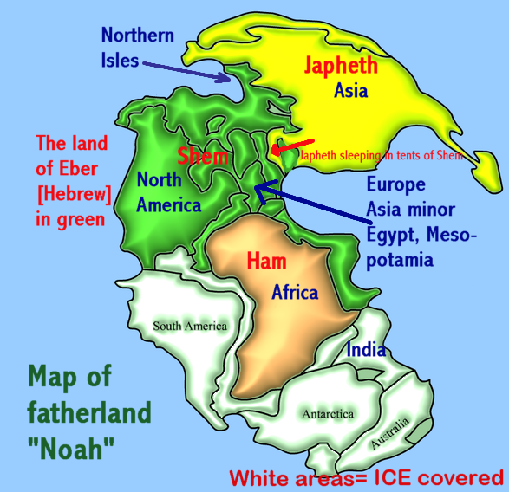
Pangaea

Slide 2
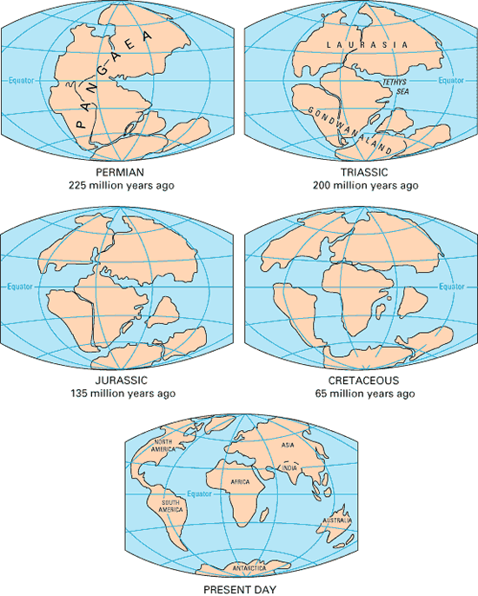
Current Continents

Slide 3
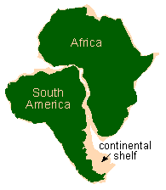
Fit of continents

Slide 4
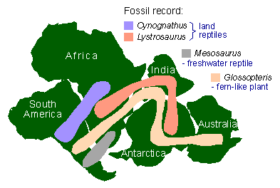
Distribution of fossils

Slide 5
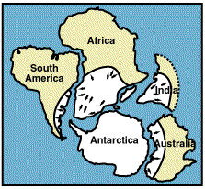
Paleoclimates

Slide 6
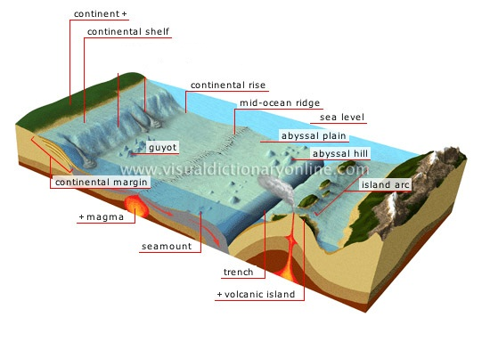
Sea Floor Topography

Slide 7
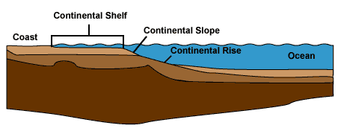
Continental Margin

Slide 8
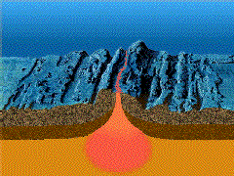
Seafloor spreading

Slide 9
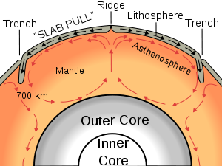
Process Of Spreading

Slide 10
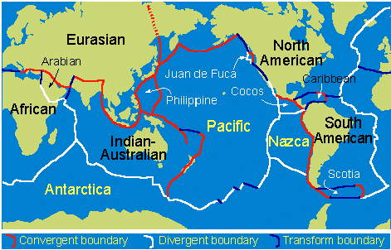
Plate Tectonics

Slide 11
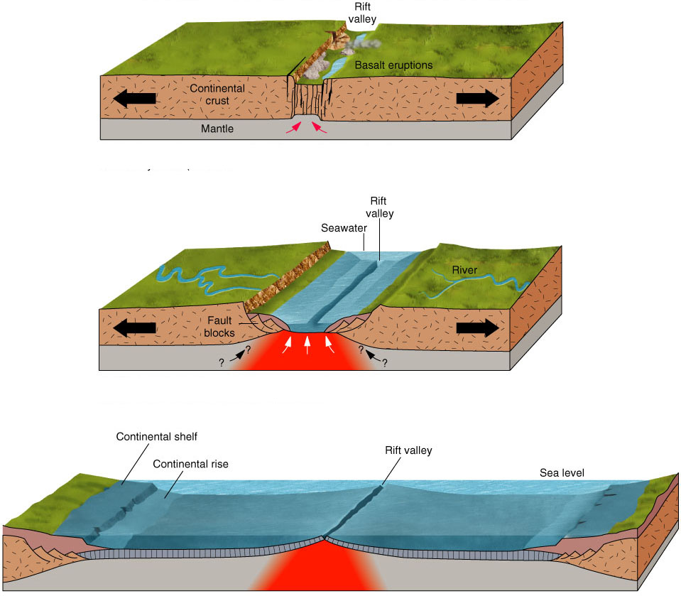
Divergent Plate Boundaries

Slide 12
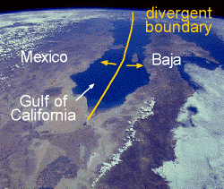
East African Rift Zone

Slide 13
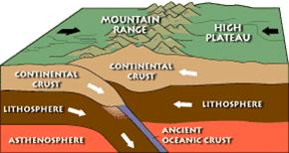
Convergent plate boundaries

Slide 14
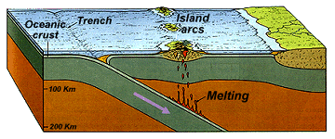
Oceanic-Oceanic plate Convergence

Slide 15
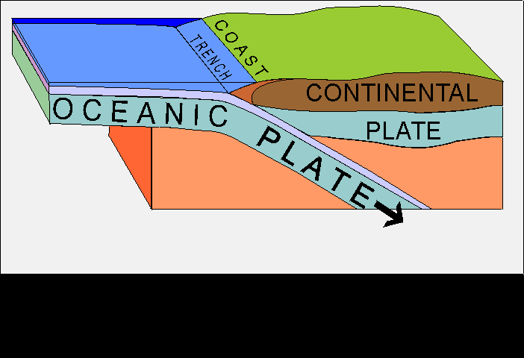
Oceanic-Continental Convergence

Slide 16
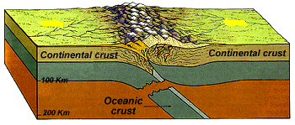
Continental-continental Convergence

Slide 17
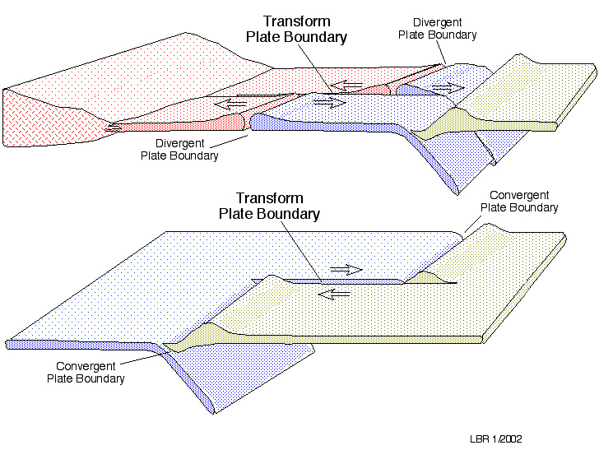
Transform Boundaries

Slide 18



