Slide 1
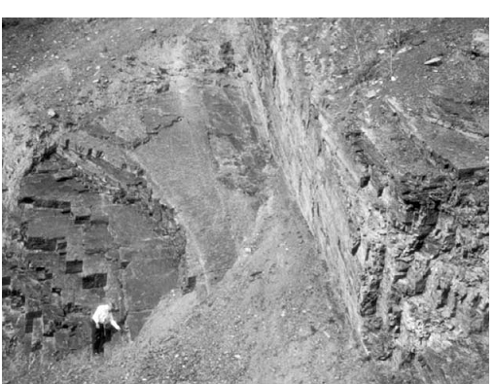

Slide 2
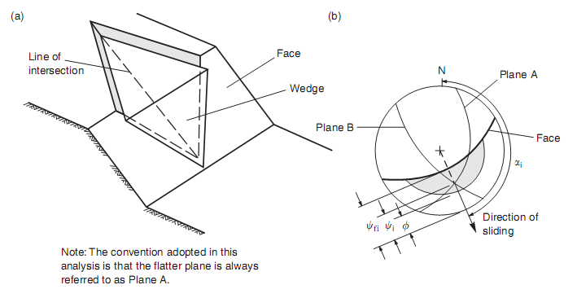

Slide 3
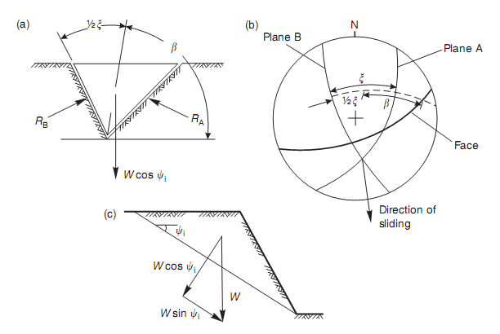

Slide 4
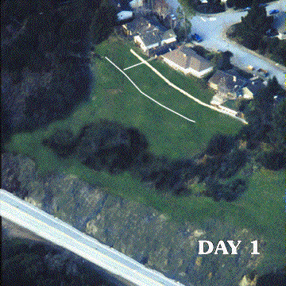
Landslides

Slide 5
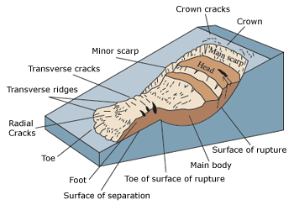

Slide 6
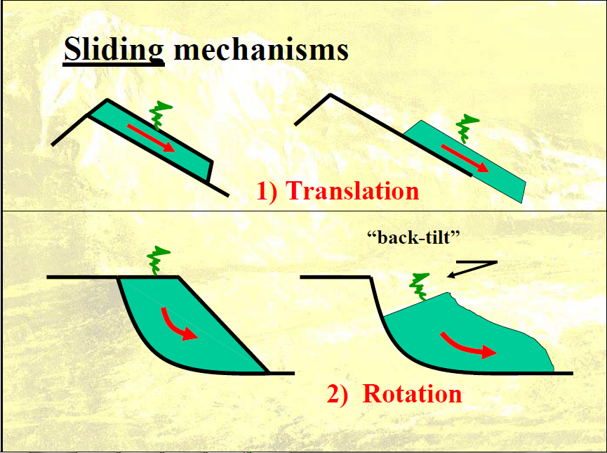
Rotational and Translational Slides

Slide 7
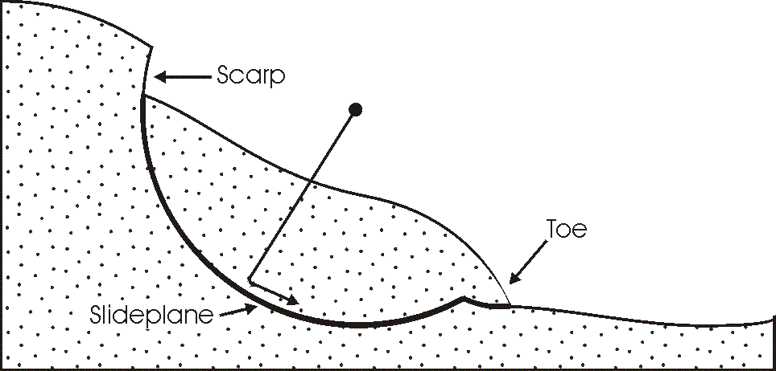
Rotational Slides

Slide 8
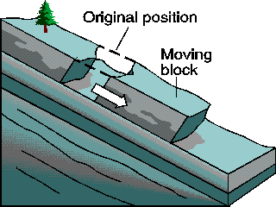
Translational slide

Slide 9
Types of Landslides
Falls
Topples
Flows
  Debris flow
  Debris Avalanche
  Earthflow
  Mudflow
  Creep
Lateral Spread

Slide 10
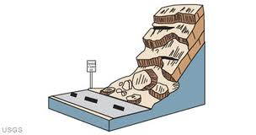
Falls

Slide 11
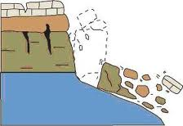
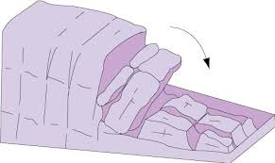
Topples

Slide 12
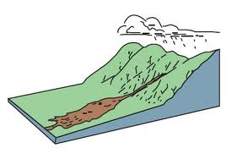
Flows (Debris flow)

Slide 13
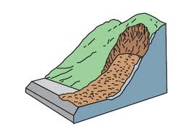
Debris Avalanche

Slide 14
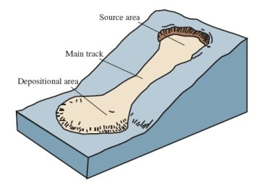
Earthflow/Mudflow

Slide 15
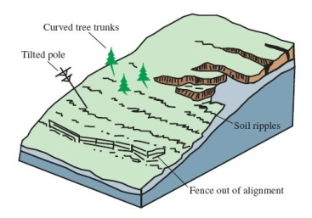
Creep

Slide 16
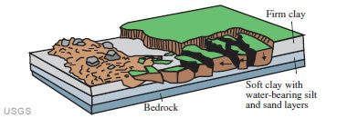
Lateral Spread

Slide 17
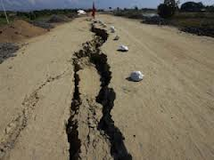
Lateral spread

