Slide 1
TYPES OF STONE MASONRY

Slide 2
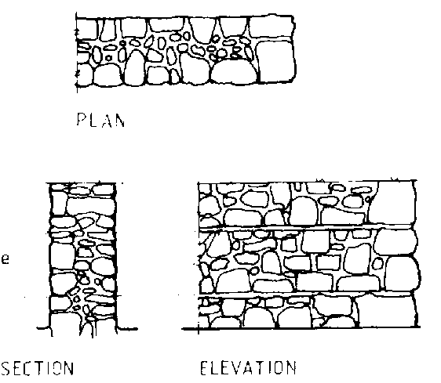
Random rubble masonry
Coursed

Slide 3
Continue….
In this type of masonry, the stones used are of widely different sizes. This is the roughest and cheapest form of stone masonry.
In coursed random rubble masonry, the masonry work is carried out in courses such that the stones in a particular course are of equal height.

Slide 4
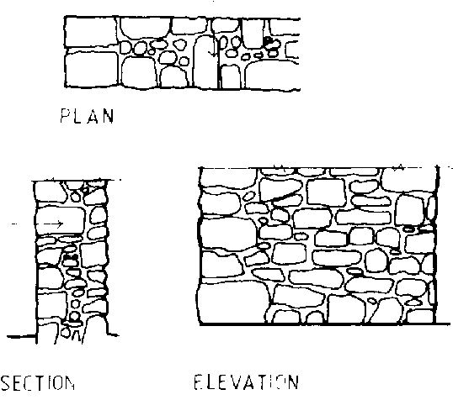
uncoursed

Slide 5
Continue….
In this type of masonry, the stones used are of widely different sizes. This is the roughest and cheapest form of stone masonry.
In uncoursed random rubble masonry, the courses are not maintained regularly. The larger stones are laid first and the spaces between them are then filled.

Slide 6
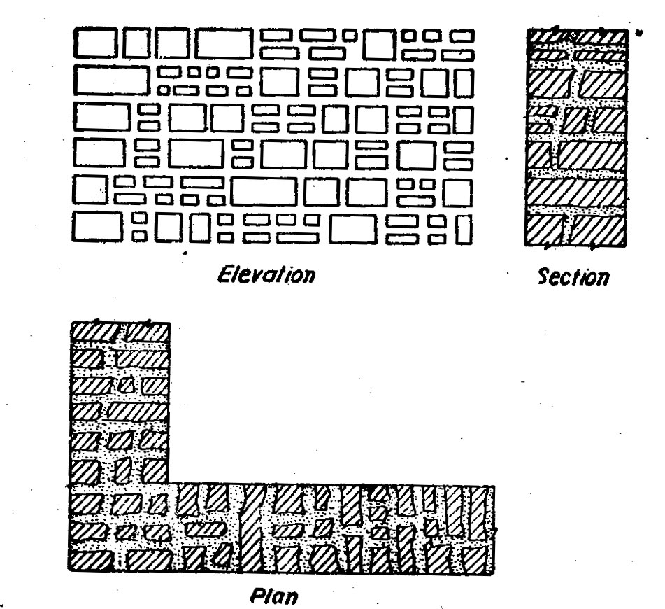
Square rubble masonry
Coursed

Slide 7
Continue…
In this type of masonry stones having straight bed and sides are used. The stones are usually squared and brought to hammer dressed or straight cut finish.
In the coursed square rubble masonry, the work is carried out in courses of varying depth.

Slide 8
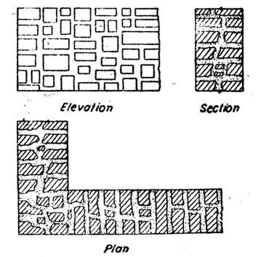
uncoursed

Slide 9
Continue…
In this type of masonry stones having straight bed and sides are used. The stones are usually squared and brought to hammer dressed or straight cut finish.
In the uncoursed square rubble masonry, the different sizes of stones having straight edges and sides are arranged on face in several irregular patterns.

Slide 10
Polygonal rubble masonry

Slide 11
Continue…
In this type of rubble masonry, the stones are hammer dressed. The stones used for face work are dressed in an irregular polygonal shape. Thus the face joints are seen running in an irregular fashion in all directions.

Slide 12
Flint rubble masonry

Slide 13
Continue…
In this type of masonry, stone used are flints or cobbles. These are irregularly shaped of silica. The stones are extremely hard. But they are brittle and therefore they break easily.

Slide 14
Dry rubble masonry

Slide 15
Continue…
In this type of masonry, mortar is not used in the joints. This type of construction is the cheapest and requires more skill in construction. This may be used for non-load bearing walls such as compound walls, etc…

Slide 16
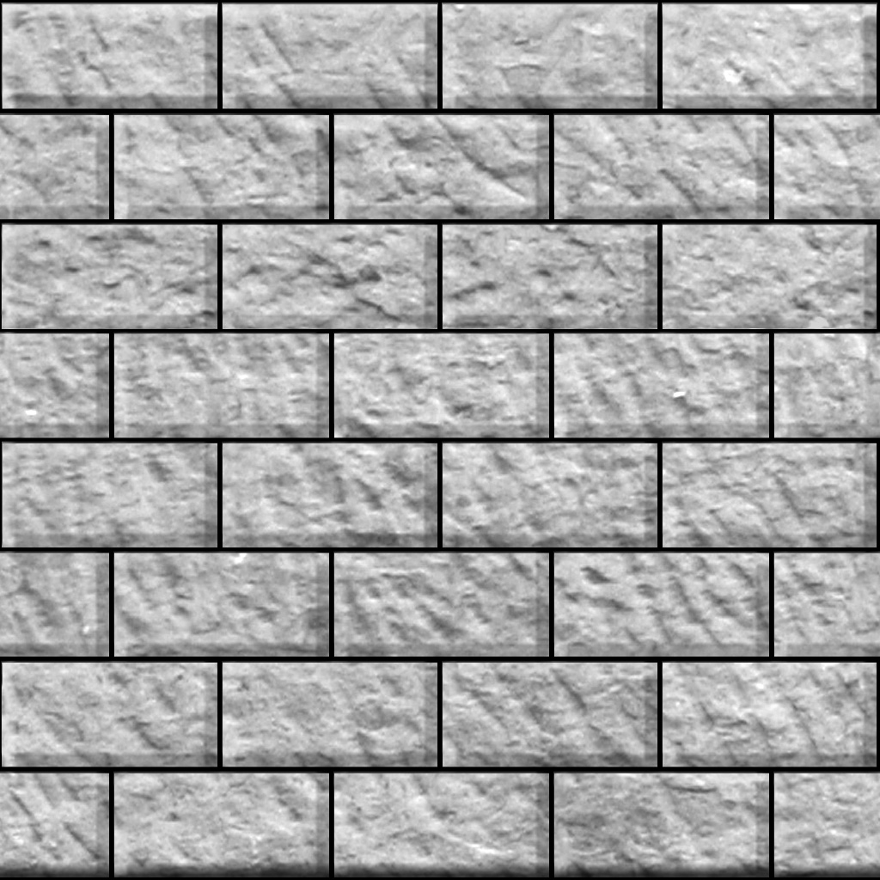
ASHLAR MASONRY
1. ASHLAR FINE MASONRY

Slide 17
Continue…
In this type ashlar masonry, each stone is cut to uniform size and shape with all sides rectangular, so that the stone gives perfectly horizontal and vertical joints with adjoining stone. This type of ashlar masonry is very costly.

Slide 18
Ashlar rough tooled masonry

Slide 19
Continue…
In this type of ashlar masonry, the beds and sides are finely chisel-dressed. But the face is made rough by means of tools. A strip, about 25mm wide and made by means of chisel is provided around the perimeter of the rough dressed face of each stone.

Slide 20
Ashlar rock or quarry faced masonry

Slide 21
Continue…
In this type of ashlar masonry, a strip about 25mm wide and made by means of chisel is provided around the perimeter of every stone as in case of rough-tooled ashlar masonry. But the remaining portion of the face is left in the same form as received.

Slide 22
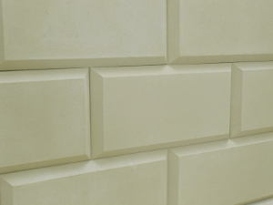
Ashlar chamfered masonry

Slide 23
Continue…
In this type of ashlar masonry, the strip is provided as earlier. But it is chamfered or beveled at an angle of 45 degrees by means of chisel for a depth of about 25mm.

Slide 24
Ashlar back in course masonry

Slide 25
Continue…
This is combination of rubble masonry and ashlar masonry. In this type of masondry, the face work is provided with rough tooled or hammer dressed stones and backing of the wall may be made in rubble masonry.

