Slide 1
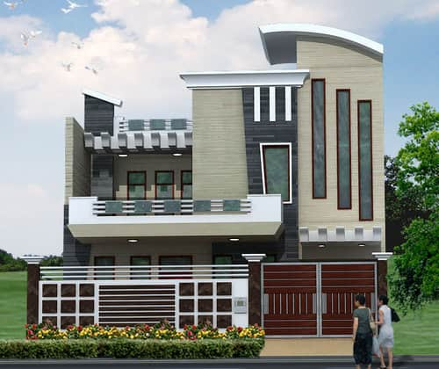
RESIDENTIAL ARCHITECTURE
Instructor:
Syed Arif Hussain

Slide 2
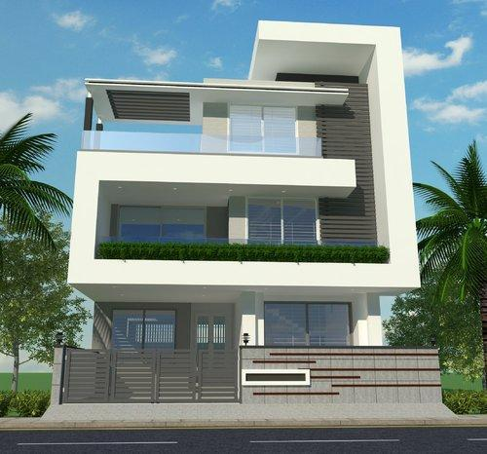
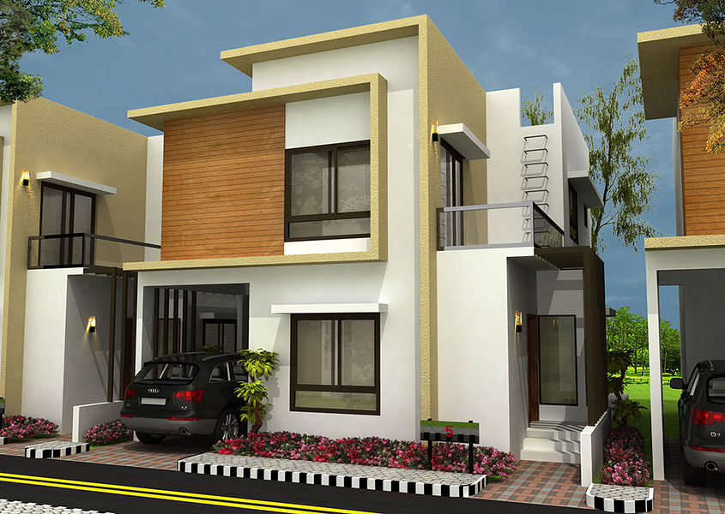
Introduction
Elevations are the part of a set of drawings that shows the exterior of a building. Typically all four sides of a building are shown on the elevation plans. Each elevation view is an orthographic projection from the floor plan. Elevations are used to show vertical relationships including finish grade, floor lines, ceiling lines, foundation and footing depths, roof pitch, roof heights and chimney heights. Exterior finish materials are also shown on the elevation plan; they include roof coverings, wall coverings, doors and windows.

Slide 3
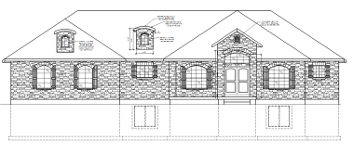
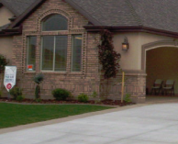
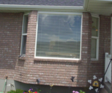
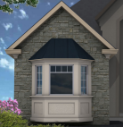
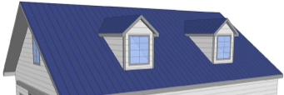
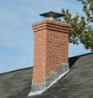
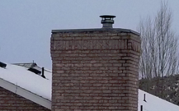
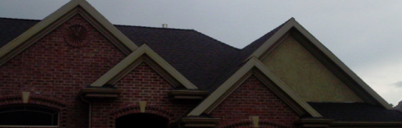
Terms to Know
As you work through this module make sure you learn the definition and use of each of the words listed below.
Graphic Example | Term | Definition
 | Elevation | Drawing that is created from the floorplan as an orthographic projection showing the exterior features of a building.
 | Finish Grade Line | The surface of the ground around the house. Used as the reference on Elevation drawings
 | Bay Window | Any Window space extending outward from the walls of a building. They can be either square or polygonal on the floor plan.
 | Dormer | Allows for natural light and increases the amount of usable space above the main floor.
 | Chimney | An upright structure containing a flue that passes smoke and gasses from fireplaces, wood burning stoves etc. to the outside of the house .
 | Ridge | The top edge of the roof where two slopes meet.
 | Fascia Board | A horizontal board nailed to the end or rafters or trusses to hide their ends.

Slide 4
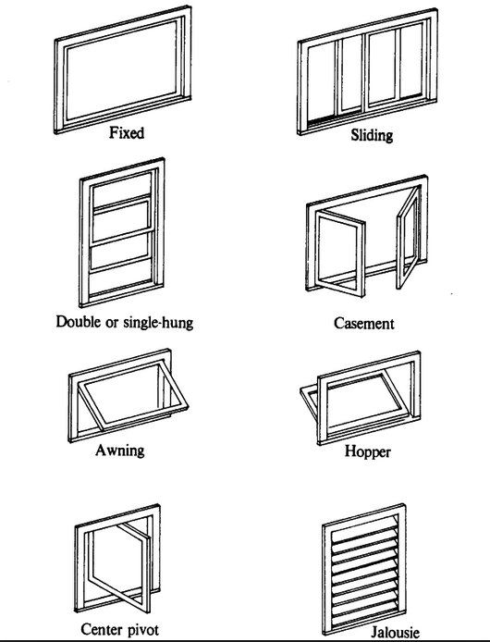
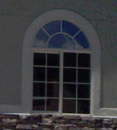
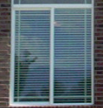
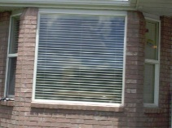
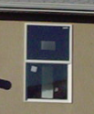
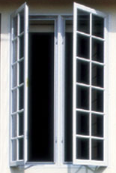
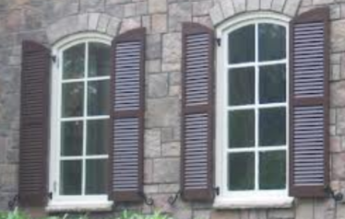
Terms to Know (Windows)
As you work through this module make sure you learn the definition and use of each of the words listed below.
Graphic Example | Term | Definition
 | Fixed (Picture) | Window that does not move or open
 | Sliding | A window that opens by sliding horizontally
 | Double or single hung | A window that opens by sliding vertically
 | Casement | A window that is attached to its frame by one or more hinges
Ca | Awning | A window that is hinged at the bottom and opens inward from the top - the reverse of hopper windows.
 | Hopper | A windows that is hinged at the bottom and opens inward from the top - the reverse of awning windows.
 | Center Pivot | A windows that is hinged in the middle and opens d from the center
 | Jalousie | A window which consists of parallel glass, acrylic, or wooden louvers set in a frame. The louvers are locked together onto a track, so that they may be tilted open and shut in unison, to control airflow through the window.

Slide 5
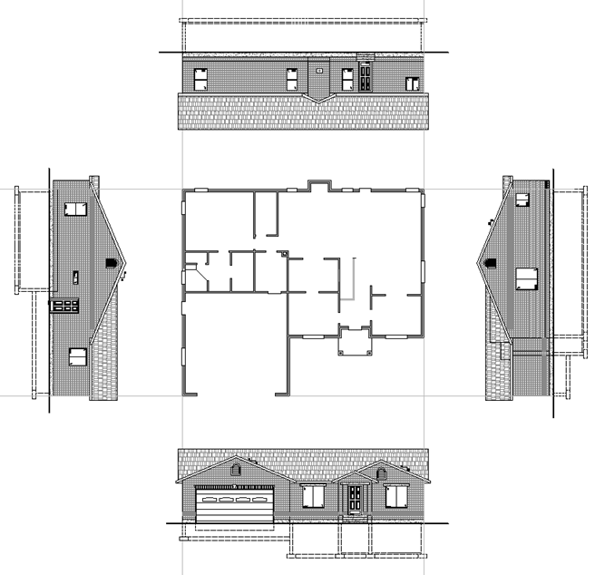
What is an elevation drawing?
Orthographic projection of each side of the house
  What does that mean
Rear Elevation
Floor plan
Left Side Elevation
Right Side Elevation
Front Elevation
Projection lines

Slide 6
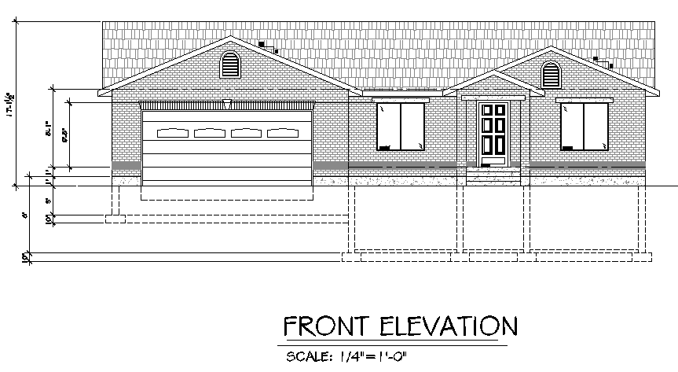
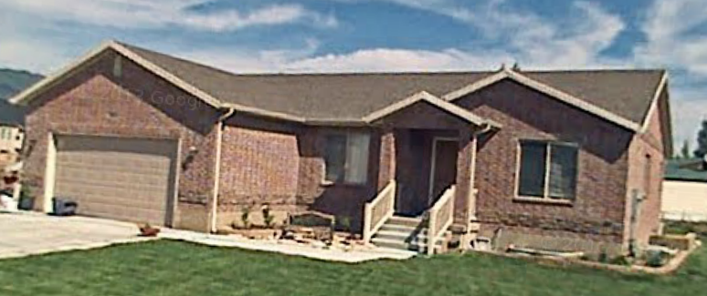
What is the purpose of an elevation drawing?
Show the finished exterior of the building
Show Height dimensions

Slide 7
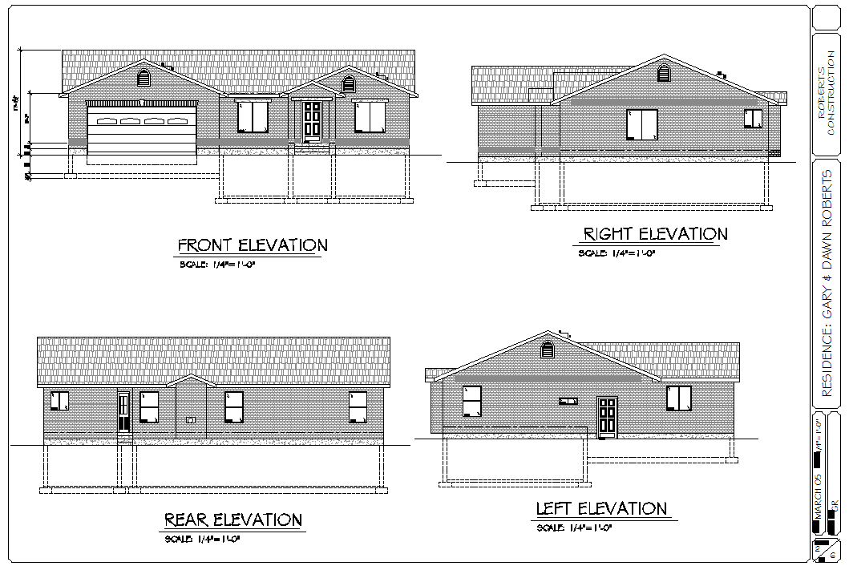
What are the required elements needed?
Show all four sides- Show other views as necessary
Identify specific sides
Printed at a scale of ¼”=1’-0”

Slide 8
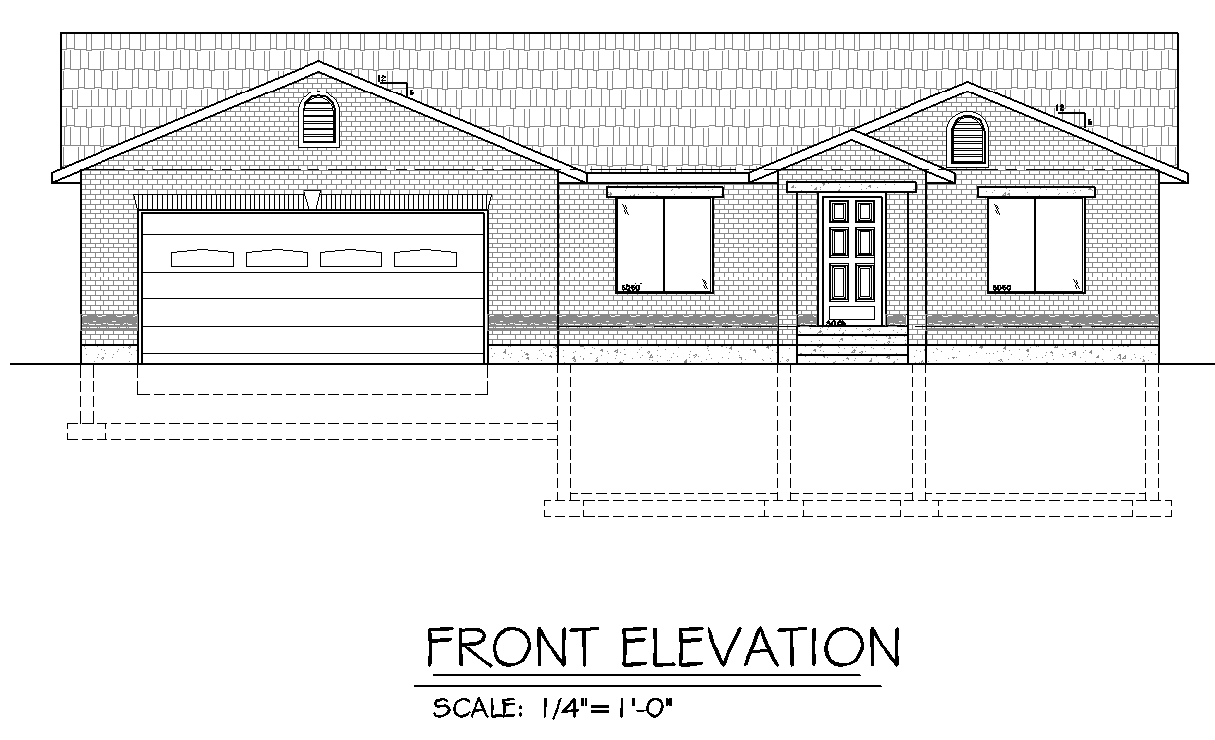
Required Elements
Horizontal Lines on an Elevation
Roof Slope symbol
Ridge line
Ceiling Line (Center Line)
Top of Windows
and doors
Garage foundation and footing
Floor line (Center line)
Top of foundation
Finish Grade line
Reference point for most elevations
Basement floor
Bottom of foundation
Bottom of footing
All lines below grade use a hidden line

Slide 9
Required Elements
Relay information
Precast decorative header over doors and windows
Asphalt Shingles
Tombstone louver
Brick Veneer
(Interpace-
Old english)
Cultured Stone
Any line below grade use a hidden line

Slide 10
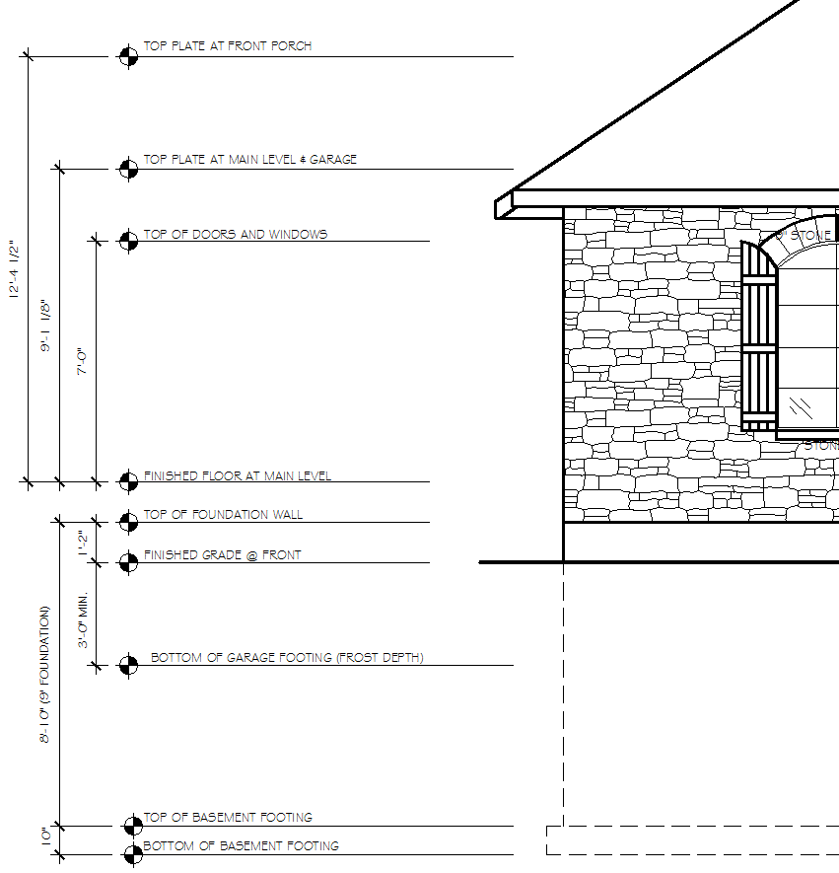
Required Elements
Show vertical height dimensions
Vertical height dimensions
Top of foundation minimum 8” above grade line
Frost Depth minimum 3’ below grade line

Slide 11


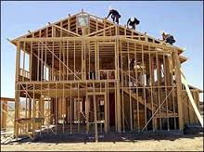
Who needs Elevation plans?
Inspector/Plan check
Contractor
Buyer/Owner
Others???
Sub-Contractors
Truss manufacturer
Engineer

Slide 12
Summary
An Elevation is an orthographic projection from the floor plan
An Elevation shows what the outside of the house looks like
An Elevation shows vertical height dimensions usually on the front view
4 Elevations are usually shown on a set of plans
Front, Rear, Right Side, Left Side
Elevations are typically printed at ¼”= 1’-0”
Used to relay information- Heights, Roof and Wall coverings,
Lines below finish grade are drawn using hidden lines
Floor and Ceiling lines drawn using center lines
Finish grade is used as a reference on an elevation

Slide 13
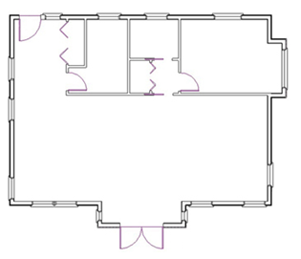

Draw House Plan
Draw Projections
Dropping Roofs
Draw Window and Doors Outline
Determine and Draw Wall Heights
Draw Baseline
Draw Stairs

