Slide 1
LDA Building Plan Approval Process
By
Rana Tahir Mehmood
Assistant Director LDA

Slide 2
Why Building Plan is necessary
Structure stability
Ventilation / Airing
Building Measurement
Fire fighting arrangement
Circulation Spaces
Sewerage / Drainage Plan
Aesthetic View

Slide 3
Steps for Approval of Building Plan
Regular Scheme Approval process
Private Scheme Approval process
Controlled Area / Private Land approval process

Slide 4
Regular Scheme Approval process
Application submission at one window cell
Drawing scrutiny at OWC
Challan for Building Plan fee issued
After depositing the fee Challan application submission
One window cell receiving receipt
File to RK
Demarcation
Ownership Verification to concerned branch
Possession Verification to concerned branch

Slide 5
Regular Scheme Approval process
After all codal formalities Form “C” will be attached by Building Clerk
File sent to Staff Officer concerned
Drawing Branch for technical report with the recommendation to sanction
Concerned ADTP for site Report
Competent authority for approval
In case of Rebuilt plan or add/alt plans reports from directorate of recovery and commercialization must be obtained.

Slide 6
Private Scheme Approval process
Application submission at one window cell
Mortgage Report at OWC by Concerned AD MP
One window cell receiving receipt
File to concerned directorate
Accounts branch for fee calculation and issuance of Building Plan Fee
Chelan to OWC
Fee deposited
Back with application
After all codal formalities Form “C” will be attached by Building Clerk
File sent to Staff Officer concerned
Drawing Branch for technical report with the recommendation to sanction
Concerned ADTP for site Report
Competent authority for approval

Slide 7
Types of Building Plan By Use
Commercial
Residential
Industrial
Public Buildings
Types of Building Plan By Construction Stage
Proposed Plan
Revised Proposed Plan
Add/Alt Plan
Rebuilt Plan
Revised Rebuilt Plan

Slide 8
Stage wise Release of Building Plan
Basement up to plinth level
Up to 38’
Above 38’

Slide 9
Documents required for Building Plan
Ownership Document / Transfer Letter
Applicants CNIC copy
Application for plan approval
Copy of possession letter
Site plan
Affidavit
4 copies of Building Plan
Forwarding Letter from Society (for Private Scheme)
Forwarding Letter

Slide 10
Documents required for Building Plan
“A” & “B” form attached
Structure Stability Report (for Commercial Plans)
Structure vetting (for Commercial Plans)

Slide 11
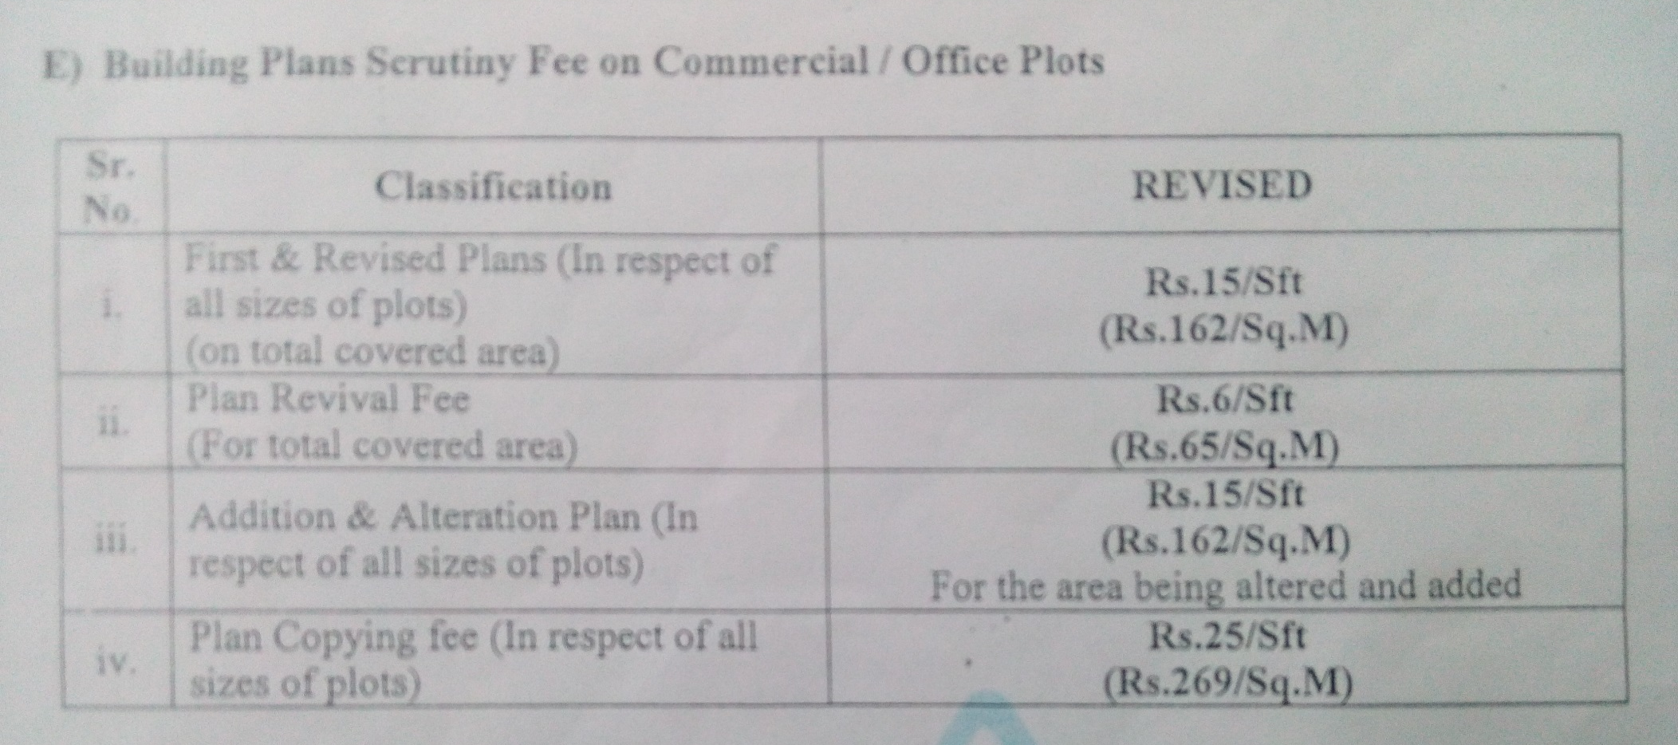
Fee Schedule
Commercial

Slide 12
Extra Height Charges

Slide 13
Design Criteria
Location Plan
Mandatory Spaces plan as per prevailing By Laws
Front Elevation
Section A-A’
Foundation Details
Internal Walls
External Walls
4.5” walls

Slide 14
Design Criteria
Stairs Details
Under Ground Water Tank Details
Under Ground Water Tank for Rain Water Details
Recharge Pit
Section for septic tank
Over Head Water Tank details
Section of RCC Beam and Lintel

Slide 15
Design Criteria
Details of Parking for public in commercial building
Detail of Slab
Schedule of Doors and Windows
Area Statement
Owner and Architect Signatures

